Slide 1

Cognizant’s Response to PJI Cloud Implementation RFP
August 2020

Slide 2







TABLE OF CONTENTS
Executive Summary
Our Understanding
Our Solution
Schedule, Risk & Assumption
Cognizant Qualification
Support Model
Pricing
Notes:
Update the Agenda items by EOD

Slide 3
RFP Questions & Response Mapping
Section | Description | Reference Slide | Page Range
5.0 VENDOR QUALIFICATION
SECTION 5.1 | ABOUT THE VENDOR | ABOUT COGNIZANT | SLIDE # 73
SECTION 5.2 | INDUSTRY EXPERIENCE | COGNIZANT’S RESTAURANT & FOOD SERVICE PRACTICE OVERVIEW COGNIZANT AZURE PRACTICE COGNIZANT AWS PRACTICE COGNIZANT GOOGLE CLOUD PRACTICE OUR DIFFERENTIATORS | SLIDE #74 SLIDE # 79 TO SLIDE # 82 SLIDE # 10
SECTION 5.3 | PRODUCTS AND SERVICES | COGNIZANT CLOUD SERVICES OVERVIEW COGNIZANT+MICROSOFT JOINT SERVICE OFFERINGS | SLIDE #75 & SLIDE # 85
SECTION 5.4 | CUSTOMERS | CASE STUDIES | SLIDE # 83 TO SLIDE #88
SECTION 5.5 | REFERENCES | CUSTOMER REFERENCES | SLIDE # 89
SECTION 5.6 | PARTNERING | STRATEGIC PARTNERSHIP WITH ALL LEADING PUBLIC CLOUD PROVIDERS | SLIDE # 76
SECTION 5.7 | FINANCIALS & BUSINESS DISPUTES | FINANCIAL & BUSINESS DISPUTES | SLIDE # 91
SECTION 5.8 | SUPPORT MODEL | SUPPORT MODEL | SLIDE # 93 TO SLIDE # 95
6.0 PROPOSED SOLUTION
SECTION 6.1 | SERVICES OFFERED |  | SLIDE # 93 TO SLIDE # 95
SECTION 6.1 | REQUIREMENTS & VENDOR CAPABILITY | GENERAL REQUIREMENTS | SLIDE # 83
7.0 PRICING
SECTION 7.0 | PRICING | PRICING | SLIDE # 97
SECTION 7.1 | INVOICING & PAYMENT | INVOICING & PAYMENTS | SLIDE # 98
Notes:
Update the slide by EOD

Slide 4
Executive Summary

Slide 5
Papa John’s Goals and Objectives
When it comes to Digitally Transforming an Organization, we at Cognizant believe in Thinking Big, Starting Small, Learning Fast and finally Scaling Fast!
With details provided in the RFP, we understand Papa John’s goals as:
Achieve 100% cloud enablement through migrating ~250 applications out of Louisville Data Center (and the DR site at Nashville) by end of June 2021. If it is an absolute necessity, a co-located Data Center can be maintained.
Envision a Multi Cloud Environment that suites the Papa John’s application landscape appropriately.
Optimize the Overall TCO (total cost of ownership) of applications and infrastructure environment and to leverage the flexibility and the benefits of the cloud.
A Realistic and Accelerated Plan balancing the Lift & Shift, Re-platform, Re-architect of applications considering the hard timeline.
Industry Leading Capabilities which supports the cloud migration program with Dashboard, KPI Driven Approach to track post migration benefits, operational efficiencies & cost modelling accuracy, security best practices etc.
And finally, A Fair Budgetary Cost for achieving the above goals and Kick Start the assessment process within one week of engagement agreement.
With our understanding of Papa John’s applications, we constituted a solution encompassing the important components of Papa John’s goals and a recommendable roadmap with optimized schedule & cost that is detailed in this response.

Slide 6
PJI’s Objective to Cognizant’s Solution Mapping
Papa John’s Cloud Migration Program Key Objective | Cognizant Solutions Lever to meet PJI’s Objective | Benefits/Value to Papa Johns
Migration DCs to Cloud by June 2021 | Our factory based accelerated migration model bundled with our Cloud partners and familiarity with PJI’s applications | Migration completed within schedule with minimal risks.
Engaging an experienced cloud migration partner | Our vast experience in DC migration to cloud | Proven methodology, process based on prior experience
Multi-Cloud landing zone strategy | Leveraging multi-cloud approach in assess, plan, manage and migrate | Multi-cloud experience and strong partnership benefits (Azure, GCP, AWS, Oracle)
Dashboard driven transparent migration approach | Leveraging Cognizant KPI driven, Arc-Tern dashboard for migration | Clear visibility into migration, operational governance
Readiness to star the assessment phase in a week | Day-1, ready to go, team to start the assessment immediately | Kick starting the migration program and assessment quickly to meet the timelines.
Identify the TCO/ROI model for cloud migration | Comprehensive TCO/ROI framework showcase benefits | Accurate TCO/ROI analysis clear benefits
Migration approach for AIX workloads to cloud | Leveraging Cognizant AIX migration pipeline and tools | Proven, repeatable approach for AIX migration with consistent outcomes
Enabling/skilling of PJI resource for ongoing cloud management | Leveraging Cognizant’s proven, comprehensive OCM framework with respect to handover | PJI’s resources enabled on cloud with mapped skills.

Slide 7





Cognizant will leverage its proven Cloud Steps for PJI’s Cloud Migration
Scope of Work for this Proposal
5
RUN
Seamlessly transition to “RUN” operations
MIGRATE & VALIDATE
Securely migrate the workloads to the cloud; validate benchmarks.
4
3
DESIGN & BUILD
Design the target state hybrid architecture, security controls,
cloud environment
2
ASSESS & PLAN
Decide on workload specific strategies; develop migration roadmaps
1
STRATEGIZE
Align cloud strategy with business and IT vision, Organizational Change Management
Assess
Plan
Migrate
Mapping to Papa John’s Phases
Manage

Slide 8
Leveraging Proven Cognizant Tools for PJI for Accelerated, Risk-Free Migration
Migration Tenants | Cognizant Tool
Dashboard, KPI driven Migration Approach | ArcTern – Cognizant ArcTern Governance, Migration and KPI dashboard driven tool for migration
Assessment and migration planning | Cognizant score-card driven cloud assessment framework Leveraging existing application knowledge
Defining accurate TCO/ROI model | Comprehensive Cognizant Cloud Economics framework to define TCO/ROI
Accelerated Cloud Migration | Leveraging automation driven Cognizant Cloud Migration Factory for accelerated migration
Landing Zone Setup | Leveraging Cognizant Enterprise Landing Zones Framework to define the foundation for multi-cloud environment
Operational Readiness | Leveraging Cognizant Cloud 360, Hive Center and iCMP tools to define, resilient operational readiness and target operating model.
Enabling and skilling PJI’s resources on Cloud | Implementing a comprehensive skilling/enabling plan using Cognizant OCM Framework (Organization Change Management)

Slide 9



Cognizant is Committed to this Program…..
Our Leadership Commitment
On behalf of Cognizant, I would like to thank you for the opportunity to partner with PJI on this strategic initiative.
We believe that the combination of our deep experience executing similar cloud migration programs and the knowledge of PJI’s application landscape built over a partnership of more than 8 years will deliver great value for this initiative. We are fully committed to the success of this program and it will get leadership attention from all Cognizant practices coming together to deliver this for you – Partha Sarathi Das
Partner Investments & Benefit
Cognizant has strong partnership with all major public cloud vendors (AWS, Azure and GCP). Cognizant will bring the benefits like investment, tools, technical validation, training/skilling, SME support in partnership with the public cloud vendor.
Cognizant has successfully migrated data center applications to cloud using partner driven programs such as AWS MAP (Migration Acceleration Program) and Azure AMP (Azure Migration Program) to migrate large workloads to Cloud. Cognizant will bring the benefits offered by the Cloud Service Providers in PJI data center migration.
Cognizant Investments/Credits
Cognizant will provide $125,000 Service Credit in this Cloud Migration program

Slide 10







Our Differentiators
Experience and Knowledge of Papa John’s Application Landscape
8+ years of strategic engagement with Papa John’s gives us a good experience and knowledge of the PJI Landscape
Cognizant did the first major cloud migration project for PJI (Mapping)
Read more about our engagement here
Proven Experience in Data Center Migration of Similar Scale
Among top 4 leaders in Gartner Magic Quadrant for Cloud Infrastructure
Delivered more than 50+ larger data center migration on public cloud
Read more here
Strategic Cloud Partnership with
Microsoft: Azure Data Partner - Gold
AWS: Premier Consulting Partner
Google Cloud: Premier Partner
Oracle Cloud: Platinum Partner - Cloud Premier Partner
Red Hat: Strategic Advanced
Read more here
Industry Recognized PeopleSoft Migration to Cloud
IBM AIX to Linux migration in cloud
Read more about one of the largest PeopleSoft case study on Oracle site here
Our Joint Security Offering with Microsoft
Azure Information Protection
Azure Active Directory
Azure Sentinel
Integrated Multi-Cloud Management - Cloud360
** Operational / Support **
Cloud360 helping organizations to swiftly provision, monitor and manage infrastructure, applications and IT-related resources in a multi-cloud environment
Read more here

Slide 11





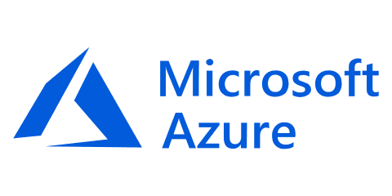
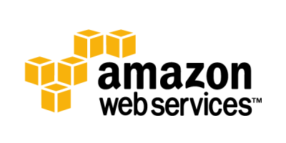
Been There, Done it. A Similar Data Center Migration Success Story for an Utility Customer
2 Data Centers (Supplier owned, in UK)
3 Landing Zones: non-standard configuration, standard x86 IaaS, Multi-tenant Cloud
~2400 Server Instances: Win (248P, 612V) | Linux (811P, 967V) | ~1.1 PB Storage (Dedicated & Shared)
6 half-rack Exadata 85 instances SAP Oracle DB | 273 Hadoop Nodes
Managed Security Services Host and DC Network Protection | Others – MFA, PAM, SIEM, FIM, Encryption
Pilot Apps Assessments
& Migrations
2016
Transition, Transformation
& Migration Factory
2017
2017
Detailed Portfolio Apps Assessment
2018 - 2020
Progressive
Apps Transform
Scope of Services
2016
Tactical POC’s
2016
2017
2018
2020
Initiation
Digital
Company
Platform for
Digital Ready Enterprise
Unified Hybrid-Cloud providing XaaS
Modernization of Business Services/Apps
Digital Delivery Model based on Infrastructure-as-Code
Enhanced Security
Business Agility
Operations Resilience
App Modernization
HyperScale Data Centre
Cost Efficiency
Security
~70% faster time-to-market
Improved SLA’s
50+ Self service catalogue
Modernize Applications estate – 18 mths
Enable PaaS
Multi-cloud
Evergreen Infrastructure
~ 35%+ TCO saving
Cloud first adoption
30+ Security controls DevSecOps
Value Delivered

Slide 12
Our Understanding

Slide 13
Overview of PJI’s Current State Infrastructure
85
2
96
AIX Servers
DATA
CENTERS
135
ORACLE DBs
3
Louisville & Nashville
DATABASES
1783
CLOUD ENVIRONMENT
200*
VMWARES
(Azure, AWS, GCP)
MIDDLEWARE
SERVERS
150
75
TB
HYPER -VMs
450 TB
295
TB
LOUISVILLE STORAGE
NASHVILLE STORAGE
~30%*
BACKUP
COTS PRODUCTS
255
~70%*
APPLICATIONS
CUSTOM APPS
* Based on our understanding of the PJI’s Landscape

Slide 14


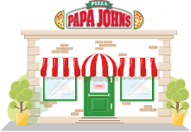


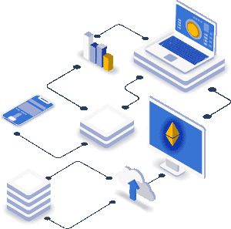

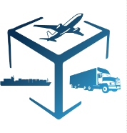



Papa John’s Application Ecosystem
Ecommerce
IT Support
& Enablement
38
Store
Operation
63
56
9
Payment
10
4
42
29
9
2
39
22
1
8
30
Application
Ecosystem
31
8
3
Data
& Analytics
3
16
24
7
Enterprise
& Operation
22
11
Hosting Type
53
59
Already In Cloud
1
7
6
3
1
18
3
43
In Store
Supply Chain
14
39
5
1
Coupons & Marketing
4
Mobile App
Not Known
Site Reliability
161
On Premise
52
Unknown

Slide 15

PJI’s Current Multi-Cloud & Hybrid Ecosystem
Store
On Premise
RWD
FOCUS
Webtools
Payment Utility Services
Reporting Modules
GDD
POBS
Product MDM
Messaging Service (MDM)
Active Directory
Doordash Drive
Product MDM Database
Papa Track Service
Mapping Services
GIS AdminTool
PapaJohns Canada website
Nutritional Calculator
Order Status Portal
Glympse API Services
Customer MDM
Analytics
Loyalty Services
PapaCall UAD
Drivosity Services
Commerce API Services

Slide 16
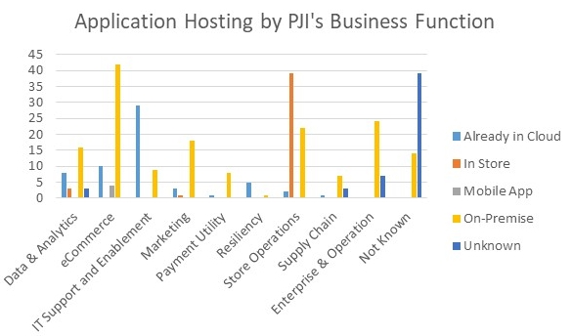
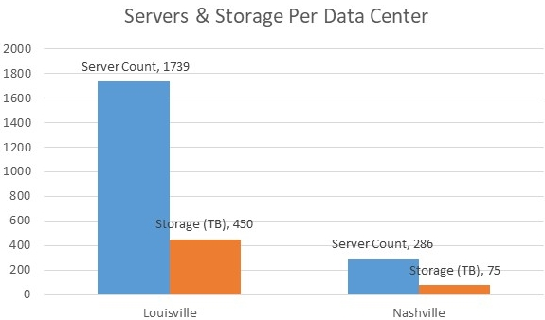
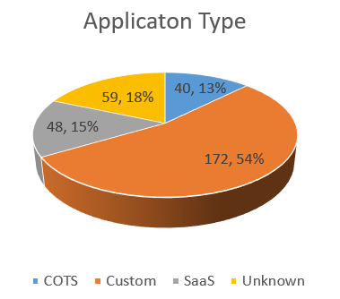
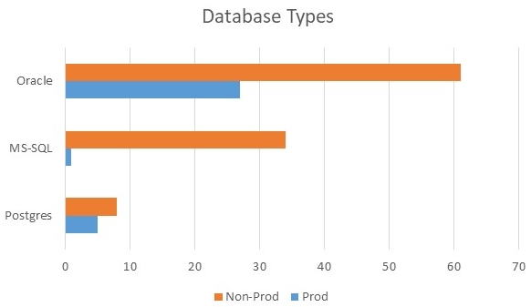
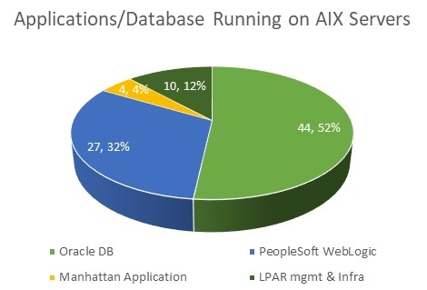
Current State Analysis of PJI’s Datacenter Infrastructure

Slide 17




PJI’s Cloud Migration – In-Scope Activities
Papa John’s is seeking for an experienced and proven Cloud Partner to assess and migrate their existing infrastructure and on premise applications to Cloud
01
02
03
04
INFRASTRUCTURE
APPLICATION
SECURITY & COMPLIANCE
ENVIRONMENT VALIDATION
Gather data, tool based poly cloud assessment
Detailed analysis of all data
Meticulous planning with intricate details from all stakeholders
Arrive with interim & long term plan per application (6R)
Design of target architecture
Migration waves and timeline finalization
Foundation setup, enhancement per new design
Lift & shift , Replatform (66) of workloads for exit by Q2 2021
Seamless migration for high critical servers, applications
Smooth Handover to PJI operations team
Collect application, DevOps, deployment, architecture details
Identify, assess application, code level vulnerabilities using FEGO
Discussion with PJI stakeholders on interim and long term plan (6R)
Wave group planning of 255 applications
Migration of 255 Applications
Uninterrupted switch over from DC to cloud keeping functional aspects intact
Functional sanity testing of the applications
Troubleshoot & remediate reported issues during functional testing
Handover applications to Papa John’s SMEs
End state security controls (NIST, PCI, current gaps etc.) requirement gathering
Assess security technology
Native/ Additional Tools finalization & Planning with PJI stakeholders
Implementation / Migration of Specific Native and additional controls, tools
Support Security control configuration during Migration.
Jointly extend security solutions with PJI team.
Handover post successful migration to PJI team
Performance test strategy & plan
Performance scripts and Load Stimulation using performance center
Load Testing [Average & Peak load – 0.5x-1x]
Stress Testing [Beyond peak load, >2x;
Soak / Endurance Testing [Average load (0.5x) for 8-10 business hours]
Failover test
Performance test monitoring & reports
Summary Dashboard

Slide 18
PJI’s Cloud Migration – Out-of-Scope Activities
01
02
03
04
INFRASTRUCTURE MIGRATION
APPLICATION MIGRATION
SECURITY & COMPLIANCE
ENVIRONMENT VALIDATION
Troubleshooting & Operational support in current infrastructure
Warranty support or hyper-care beyond two weeks post successful migration & signoff
Decommission of infrastructure post migration
Functional enhancements and resolution of existing functional / technical issues in applications
Complete Re-architecture / Re-write of applications
Changes to database / table structure for Refactor / Replatform applications
New non-functional requirements like data purging, encryption etc.
PeopleSoft migration is optional service which we will confirm after discussion with PJI during Assessment
Current or Additional security tool licenses
Akamai WAF + DDoS + BOT protection, ISP DDoS Protection
SIEM build and license.
Secure code review, DAST
Audits or Audit support for regulatory compliance requirements during migration
Performance testing - analysis of any functions/ transactions/ components/ channels other than identified as scope
Code-profiling
Accessibility /Client side performance Testing
Native Mobile application /Device level performance engineering

Slide 19
Our Solution

Slide 20
Cognizant Will Leverage its Proven Cloud Steps Framework Customized for PJI’s
Scope of Work for this Proposal
5
RUN
Seamlessly transition to “RUN” operations
Assess 255 application
Data collection using inventory, existing tools & Cloudscape
Interviews with application and business stakeholders
Arrive at 6R strategy
Robust design taking into consideration Papa John’s functional and non functional requirements
Enhancement or fresh build of Cloud Foundation based on CSP and existing footprint
Detailed Migration Plan
Non-Prod during week days
Production during weekends within minimal cutover for high critical applications
Validation of the migrated environment and Hyper care for a week.
Seamless handover to Papa John team on successful end of Hyper care.
MIGRATE & VALIDATE
Securely migrate the workloads to the cloud; validate benchmarks.
4
3
DESIGN & BUILD
Design the target state hybrid architecture, security controls,
cloud environment
ASSESS & PLAN
Decide on workload specific strategies; develop migration roadmaps
2
1
STRATEGIZE
Align cloud strategy with business and IT vision, Organizational Change Management
1. Assess
2. Plan
4. Migrate
Mapping to Papa John’s Phases
3. Manage

Slide 21






Technology Innovation through Our IPs and Accelerators
ZDLC
Value Stream Mapping
APPLENS
CloudFrame
COSMOS
Application Portfolio Assessment Framework to determine workloads that should be migrated to the cloud
Helps to extract detailed business rules embedded inside code without excessive dependency on SMEs
Solutions to reduce risk, cost and time to value while increasing predictability for new and transformed applications
Data rich decision making tool to assess impact of Cloud for Digital Strategy
Development Platform for End-to-End Microservices Design and Implementation.
Arc-Tern
OneDevOps
Cloud Steps
IaC Generator
Migration Factory
Easy to use, collaborative migration management and governance tool to accelerate time to cloud
Integrated DevOps professional services platform to drive enterprise DevSecOps for enhanced Time to Deploy & Time to Value
Cloud Transformation Framework to drive cloud adoption that elevates organizations to a digital ready state
Generate Customized Terraform Code Without Having to Know Coding
Migrate legacy workloads from On-Premise to Public Clouds (re-host) including Enterprise Applications
Foundation Automation
DIAL: Delivery Integration & Liaison
Cloud 360
HiveCenter I&O
Cloud Anchor
A rich repository of IaC scripts for rapid cloud foundation setup
Platform to assure functionality and performance of migrated workloads
Next Gen Service management framework focused on integrated business-IT service delivery
iCMP platform for on-demand service experience for improved agility, efficiency and better governance
Integrated Automation ecosystem to deliver new digital capabilities to offer unique CX and power growth
To be used for this Program
Other Cognizant IPs & Accelerators

Slide 22
Cloud Assessment – Detailed Activities
ASSESSMENT
PLAN
MANAGE
MIGRATE
1. Discovery
2. Analysis
3. Strategy
Infrastructure – network, storage, server inventory, sizing, utilization, dependency mapping
Application – app and database details, app to infra mapping, compliance, licensing, integrations, configurations, availability, user experience, security, performance, data ingress/egress
Business – strategy, roadmap, criticality, BC, RTO, RPO, DR strategy & requirement validation of multi-cloud, DR method, user spread, growth strategy
Cloud Fitment Analysis - Is the application fit to be hosted on Cloud?
Cloud Migration Viability Analysis - What treatment does the application require to be migrated to cloud?
TCO Analysis – How much will it cost to host applications on cloud?
Cloud Migration Strategy – Identify 6 R’s - Retain, Rehost, Re-platform, Replace, Refactor, Re-architect
Business Case - Is there a business case for application to be migrated to cloud?
Landing Zone Recommendation– Landing zone recommendation for the workload based on Tech Stack, NFR and strategy.
ACTIVITIES
Discovery Tools (Leverage existing tool)
Interviews and workshops
Existing Application info & Application-Server mapping
CMDB and other central data sources
Existing documentation
Cognizant AHP Tool
Cognizant VSM / Source Code Analysis Tool
Cognizant CloudFrame / Cloud TCO Calculator
Cognizant Cloud Migrate Planner
TOOLS

Slide 23

















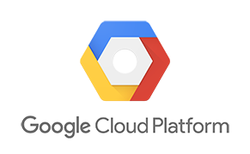





Cloud Suitability Assessment Process
ASSESSMENT
PLAN
MANAGE
MIGRATE
Discovery
Analysis
Recommendations
Tools & Frameworks
Consultant
Assessment Findings
Reports
Landing Zone Recommendations
Tools
Discovery
Reports & Signoff
Migration Strategy
Architect/ SMEs
Client Knowledge & Decision Criteria
Business Case
Interviews
Cognizant Cloud Assessment Model
Cognizant Cloudframe
Icon Tool

Slide 24
Cognizant Cloud Assessment Approach for PJI
ASSESSMENT
PLAN
MANAGE
MIGRATE
Application Portfolio
App2
Step 1
Rationalization & Cloud Suitability
App1
Step 2
Cloud Viability
Analysis
Refactor
Rearchitect
App3
App4
Rehost
Replatform
App 1
App 2
App.N
App1
App 2
Refactor
Retain/Retire
Full Stack Discovery
App N
Functional
Infrastructure
MIGRATION STRATEGY/
LANDING ZONE
Identifying Migration Strategy
Non - Functional
Operations
Reducing Application Density
BUSINESS CASE & TCO
Infrastructure
Application Dependencies
Business Criticality
Security
Database
Security
Compliance
Regulator Compliance
Technology
HW/OS Dependencies
License Portability
Sample Tools and Workload Dependency Analysis for Assess & Plan
Cognizant Accelerators for Assessment
Multiple Landing Zones

Slide 25







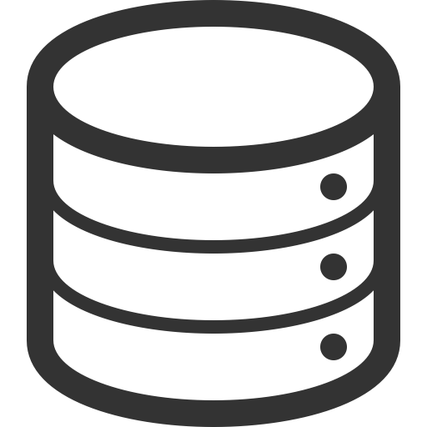
Parameters Analyzed For Assessment
ASSESSMENT
PLAN
MANAGE
MIGRATE
Cloud Fitment Assessment
Cloud Migration Viability
Regulatory & Compliance Requirements
Application Dependencies
(Up-stream, Downstream,
Integration Points, Geo spread)
Cloud
Fitment
Support for technology
(Application Type, Technology Stack, Operating System)
Business Criticality
(Application availability, Criticality to Business )
Infrastructure Dependencies
(H/W Platform + OS Dependencies)
Security Requirements
(Encryption at Rest/in Transit, Authorization, Authentication, Security Requirements)
License Portability
Database
(DBMS Version, Clustered, Throughput, Shared App workloads)

Slide 26
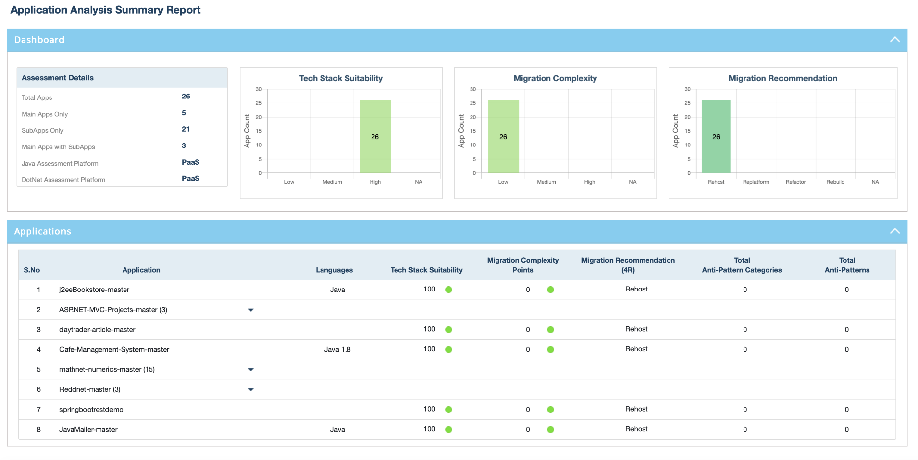
Application Assessment Approach – Replatform / Refactor
ASSESSMENT
PLAN
MANAGE
MIGRATE
Breakup of in-scope applications (30% COTS and 70% home-grown) 90% of home-grown apps can be Rehosted to Cloud Remaining 10% will need to be Refactored (3%) / Replatformed (7%)
Inventory of applications that are not found suitable for the Rehost migration approach
Discovery phase reports, application to infrastructure mapping, application tech stack details, upstream and downstream dependencies
Business criticality and other non-functional inputs
Inputs
Assumptions
Deep Dive analysis of current application and deployment architecture.
Get a copy of the codebase of the specific applications
Execute Cognizant proprietary Digital Engineering Platform – FEGO on the codebase to identify code level vulnerabilities that will need to be remediated to migrate to cloud
Discuss with Papa John’s stakeholders and agree on Refactor and Re-platform findings and remediation recommendations
Sample FEGO output
Activities
Finalized end state disposition (Replatform / Refactor) of specific set of applications
Future state application and deployment architecture
Application migration complexity and effort
Deliverables

Slide 27
Environment Validation Assessment Approach
ASSESSMENT
PLAN
MANAGE
MIGRATE
Overview of Assessment
Assessment Approach
Performance Assessment will be conducted for 255 PJI applications to identify the top critical applications which will be performance tested
(Will be determined in consultation with PJI)
Application with high end user concurrency
Critical business Flow
High Hardware Resource Utilization
App1
App2
App3
High Visible Application
Assessment Parameters
Performance Assessment
Application Changes
Major Functional change (If any)
Hardware (Cloud Migration )
Software (If any)
Production Monitoring Stats
Production performance
Existing Performance baseline
Application Attributes
Business Criticality (Will be determined in consultation with PJI)
Applications already in scope for performance testing
Concurrent Users like(> 500,250-500,100-250,25-100,< 25)
Availability (<95%, >95% & <=99.9%, >99.9%) (Assuming)
Assumption
Will consider Top 15 Critical applications for performance testing (considering mainly the below)
e-commerce
Corporate
Any other performance critical applications
Tools and NFR’s will be determined by help of PJI
Outcome
Top Critical applications for performance testing covering
Determine Performance and OAT NFR’s for performance critical application with help of PJI team
Determine Cloud Performance / Application Monitoring Tools

Slide 28
Total Cost of Ownership (TCO) – Laying the Foundation for Analysis
ASSESSMENT
PLAN
MANAGE
MIGRATE
To establish cost transparency and develop initial hypotheses on areas of excess spending, the Total Cost of Ownership (TCO) of the IT portfolio and for each application was calculated …
L
Total CRICO IT TCO
Total Software Costs
Per Application Software Licensing Costs
Application TCO
Total IT TCO
Application software licensing as applicable to corresponding applications
H
40%
Apportioned based on CPU and Memory allocated to each application
Total IT Infrastructure Cost
Compute Cost
Per Application Compute Cost
Per Application Infrastructure Cost
30%
Apportioned based on storage allocated to each application
Storage Cost
Per Application Storage Cost
30%
Apportioned based on network bandwidth used by each application
Network Cost
Per Application Network Cost
P
Total IT
Personnel Cost
Total IT staff salary and spend on vendors apportioned according
to effort distribution across applications. This includes both project work and support
Per Application Personnel Costs
Expenditure incurred on Cooling , Power , Data Centre. These costs are not typically directly traceable to applications and is based on assumptions
O
Per Application Other Spend
Other Costs

Slide 29
Responsibility Matrix
ASSESSMENT
PLAN
MANAGE
MIGRATE
Phase | Cognizant Responsibilities | PJI’s Responsibilities
Discovery | Configure discovery tool in PJI environment Run and collect the data from the discovery tool Analyze the data | Provide necessary information and access to configure discovery tool Validate and sign off discovery data
Planning | Identify applications Validate scope Produce assessment plan Set-up project Share questionnaire Identify key Stakeholders & their involvement, as required | Identify broader key stakeholders across various functions Provide access to stakeholders schedules Ensure availability of SMEs and 3rd party vendor resources where required Schedule interviews Access to CMDB and other data sources
Tech Analysis | Identify & collect information from existing data sources Gather App & Infra details and organize by Platforms for all in scope applications Understand any gaps in data collection and prepare in-person workshop agenda/structure Publish questions and survey to the stakeholders and collect data Complete analysis with any follow-up questions/workshops Workshops/sessions/offline-data collection with PJI SMEs | Provide assistance on any missing information/gaps in the discovery Provide assistance in setting up onsite meetings with various SME’s Provide access to Application source code, binaries, dependencies and installation/configuration guides Share documentation on all inventory, landscape and job responsibilities Completion of data collection questions by PJI SMEs and IT Personnel Provide business use cases and non-functional requirements like security, performance etc.
Analysis | Qualitative analysis Analyze in scope infrastructure landscape, inventory data Identify Patterns/Groups and decide on cloud fitment | Validate the Application Grouping and provide inputs Other inputs/validation around application roadmap, ongoing initiatives, etc., which will be valuable to Cloud Roadmap Review Analysis and help refine
Recommendations | Create Migration plan, Cloud Fitment Analysis based on Current costs availability Refine and rework the deliverable based on feedback Produce migration plan | Timely Review and acceptance of deliverables Ensure participation from key stakeholders Provide details on on-premise spending for TCO analysis

Slide 30
Time & Effort Required from PJI Resources During Assessment
ASSESSMENT
PLAN
MANAGE
MIGRATE
Roles | % of Hours/Week | Total # of Weeks
Project Sponsor / Executive Leader | 5% | 8
Program Manager/Lead | 50% | 8
Enterprise Architect | 25% | 8
Application Owners (aggregated) | 10% | 8
Infrastructure Architects and SMEs | 25% | 8
Security SME | 25% | 8
Process Owners | 10% | 8
DevOps SMEs | 10% | 8
IT Operations SME | 25% | 8

Slide 31
Assessment Phase - Deliverables
ASSESSMENT
PLAN
MANAGE
MIGRATE
# | Deliverables | Content
1 | App Discovery Report | Application, Infrastructure, Security, License details for the in-scope application portfolio App discovery and high level assessment for all servers as indicated on Slide 3
2 | Cloud suitability assessment report | Cloud Fitment score derived based on parameters like Regulatory & Compliance, Support for Technology, HW/OS Cloud Migration viability derived based on parameters like tech stack, App dependency, Availability, RPO/RTO, Security and DB Setup Application categorization for migration into re-host, re-platform and refactor migration strategies.
3 | Cloudscape Report | * Cloudscape App Details
5 | Target Cloud Sizing, Migration Efforts | AWS & Azure hosting cost collectively for the entire application/infra portfolio assessed ( where infra details available) Migration cost for taking these applications ( as per planned move groups) to AWS, Azure
6 | Handover | Assessment Report Draft Plan for Transition to Future State Operating Model
7 | High Level Strategy & Roadmap | Organization structure requirement (Role requirement and role definition, training, capability definition, timing – people-oriented roadmap) High level Roadmap outlining transformation requirement High level operating model
Notes:
Rechange the terms

Slide 32
Planning Phase – Overall Approach
ASSESSMENT
PLAN
MANAGE
MIGRATE
Migration Planning
Multi Cloud Landing Zone Setup
Pilot Implementation
Detailed Migration Plan
Wave Grouping and Wave Planning
Sprint Planning
Milestones
Release and roll-out planning
Testing methodology and schedule
Cutover planning
Multi-Landing Zone Setup
Account/Subscription
Network
Security
Operations
DevOps
Reference Architecture
Automation scripts
Identify pilot applications (rehost, re-platform (windows), re-platform (AIX)
Implement Pilot
Observe and Monitor pilot
Refine the foundation

Slide 33
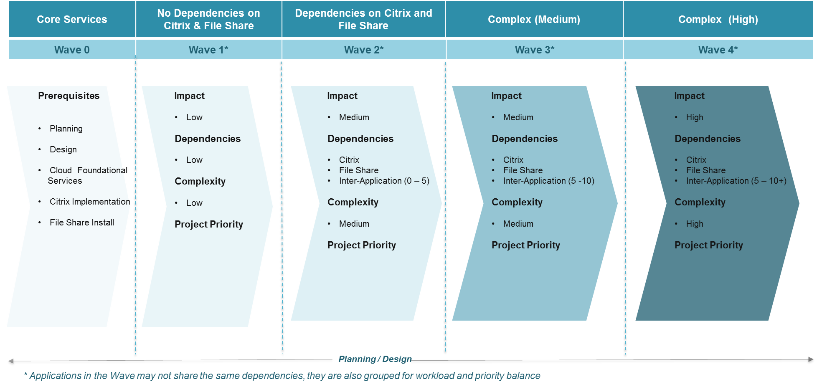
Move Group / Wave Group – Planning Approach
ASSESSMENT
PLAN
MANAGE
MIGRATE
Parameters considered for Move Groups and Migration Waves
Once we determine application cloud suitability, we recommend move groups/ migration waves based on logical parameters.
Organization specific parameters are taken into consideration as well
Business Criticality/
Priority/
Impact
Effort for Migration/ Complexity)
Order of Business Unit
Dependencies
App/Infra types - .NET/Java/SQL etc.
App Environment – Dev/ Test/ Staging/Prod

Slide 34
Cognizant will leverage Enterprise Landing Zone Framework
ASSESSMENT
PLAN
MANAGE
MIGRATE
INPUTS
DESIGN AND BUILD
OUTCOME
Assessment Report
Develop Cloud Deployment Model
Develop Cloud Service Models
End State Architecture
Risk Mitigation
Final Migration Plan
Migration Kit
POC Areas
Integration Points
HLD & LLD
Solution Analysis and Design
Base Environment build
Application
Dependency
Firm up on Migration Plan
ITIL policies Process & Governance policies
Workload Categorization and Move group formation
DR Recovery enablement
Cloud Strategy
Proof of Concept
Setup Cloud Foundation
HLD & LLD, BoM
Infrastructure provisioning
Business Case
Security and Network Design
Handover

Slide 35

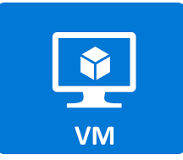
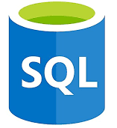




















Multi-Cloud Reference Architecture – Indicative
ASSESSMENT
PLAN
MANAGE
MIGRATE
PJI Users
PJI Stores
Av ailability Zone 1
Av ailability Zone 2
Av ailability Zone 1
Av ailability Zone 2
IaaS VMs
IaaS DB
IaaS VMs
IaaS DB
IaaS VMs
IaaS DB
IaaS VMs
IaaS DB
ASR
Azure AD
Azure AKS
Azure AD
Azure AKS
Big Query
Kubernetes
Big Query
Kubernetes
Azure East 2
Service Now (ITSM, ITOM, SAM)
Azure West
Us-east
Service Now (ITSM, ITOM, SAM)
Us-west
Av ailability Zone 1
Av ailability Zone 2
IaaS VMs
IaaS DB
IaaS VMs
IaaS DB
Amazon S3
Amazon EBS
Amazon S3
Amazon EBS
AWS—US East Ohio Region
Service Now (ITSM, ITOM, SAM)
AWS—US East Region

Slide 36











Proposed Multi-Cloud Operating Model for PJI
ASSESSMENT
PLAN
MANAGE
MIGRATE
Financial Governance
Technology Governance
IaaS
PaaS
CaaS
IaaS
CaaS
IaaS
PaaS
Cloud
Financial
Office
Application
Application
Application
Cloud
Technology
Office
Operations Governance
Driving Digital
Business Models
Visibility, Allocation
& Optimization
Cloud
Service
Management
Office
Automated
Manual
Provide oversight to control cloud sprawl and shadow IT
Integrated Performance Monitoring
Standardize and
accelerate cloud services adoption
Monitor & auto_manage
Intelligent Automation Platform
Resource Governance
Integrated Service Desk
(Infra, Apps)
Customer & Cognizant
(not part of core Cloud Operation Services)
Systems of Record
Self Service
Resource
Governance
Office
Automated Configuration Management
Integrated Operations Team (DevOps)
Systems of Engagement
Continuous Compliance
Systems of Execution
Agile Operations Pods
Policy Based Automation
One Click Deployment/CI/CD
Cloud Operators
Customer & Cognizant
Systems of Reporting, Assurance & Governance
Cloud Architects
Service Delivery Management
Integrated Security Management & Governance

Slide 37
Security Control Assessment Approach
ASSESSMENT
PLAN
MANAGE
MIGRATE
Security Control Mapping Approach & Control catalog Development
Cognizant Control Framework
Remove duplicate controls
Identify & Update Overlapping Control
Review cost of control
Control Objective alignment
PJI Controls
PCI DSS Standards
PJI Control Framework
PJI Controls Catalog
Cloud Security Standards
SOX Controls
NIST CSF
CIS CSC
Optimized Control Catalog for implementation & maturity
Factors for consideration for Control development
Review all Control Requirements

Slide 38
Plan Phase - Deliverables
ASSESSMENT
PLAN
MANAGE
MIGRATE
# | Deliverables | Content
1 | Detailed Migration Plan | Overall Wave group Plan and sequencing at high level for CxO’s Prepare below details and get signoff from all teams involved viz. Business, Application, Infrastructure, Operations support etc Applications in each Wave report with classification of the 7 environments LOB wise report Overall Migration sequencing Intricate details of each pre/post wave No. of applications being migrated day, week wise No. of servers being migrated day, week wise Communication plan to end users, business stakeholders, support teams Pre-Migration During migration Post Migration Cut Over plan for each application DR Implementation plan with DR architecture and methods of implementation Downtime callout if any and sign off from each application owner with expected duration and reason Schedule of CAB (Change Advisory Board) meetings, calls List of Change Request approvers, owners, alternative owners Discussions & Sign off from all stake holders for all the above
2 | Design Documents | Target Architecture, design document HLD, LLD for Compute, Storage, Backup, Database, Middleware, Security Target backup policies inline to PJI strategy with modified server specific agent requirements, if any, native snapshots Signoff from Papa John Architecture Review team and design team experts Automation IaC scripts readiness for migrations Debrief with technical teams and all clarifications addressed and sign off from Migration Lead, Architect
3 | Cost | Arrive at current costs based on PJI’s inputs Target cost model based on target design in the interim and long term
Notes:
Rechange the terms

Slide 39
Manage Phase – Overall Approach
ASSESSMENT
PLAN
MANAGE
MIGRATE
Program Governance
Operational Governance
Process Governance
Program Governance
Communication Model
Escalation approach
Status report
Dashboard showing key KPIs
Key KPIs for Operational Governance
Target operating model
Finance, Technology, Service and Security Governance
Organization Change Management
Skilling/enabling PJI FTEs
Detailed knowledge base and documentation

Slide 40




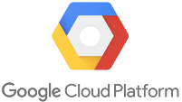





Overall Program Governance Model
ACTIVITIES
LEADERSHIP COMMITTEE
Organizational Vision and direction
Corporate governance
Executive Sponsor
Client Partner
Engagement Delivery Partner
STEERING COMMITTEE
Business Level objectives
Engagement Roadmap
Policies and procedures
Program Sponsor
Engagement Partner
Engagement Delivery Lead
Alliance Director
PROGRAM MANAGEMENT OFFICE
Project Plan
Project Level Objectives
Project Governance & Tracking
Weekly reporting
Program Managers
Program Director
Offshore Project Manager
Project Team
(Onsite)
Project Team
(Offshore)
Application assessment
Migration planning
Day to Day Implementation
Post migration validation
Quality Audits
Daily reporting
PROJECT DELIVERY TEAM
Infra Migration
App Migration
Infra Migration
App Migration
Alliance Architects
Lead
Lead
Lead
Lead
App & Infra SMEs
Engg. &
SME
Engg. &
SME
Engg. &
SME
Engg. &
SME
Public Cloud Partners*
Security
Testing
Security
Testing
Lead
Lead
Lead
*Cognizant has strong partnership with major public cloud providers
Lead
Engg. &
SME
Engg. &
SME
Engg. &
SME

Slide 41
ArcTern – Cognizant will use it’s flagship Governance Tool to Deliver PJI Migration
ASSESSMENT
PLAN
MANAGE
MIGRATE
MANAGEMENT DASHBOARD AND REPORTS
INVENTORY DATA
MIGRATION PLANNING
WAVE PLANNING
MIGRATION UPDATE
Single pane view of the status of all migration activities. Ability to export Dashboard data
Ability to capture inventory details for 55 standard fields and functionality to add dynamic fields
Upload inventory from external tool
Ability to add Application dependencies, Waves, Criticalities, Migration schedules
Generate pre created Run books based on the type of migration
Preview and Edit Run Books before generating Run Book
Detailed run book and T plan status updates for all migrated inventory items
Reporting of Progress v/s Plan, Success rate, Rollbacks, failures and issues/risks
Reporting of Migration Status by day wise and engineer wise
Alerts for scheduled activities and delays. Notifications to stakeholders on status updates
Search filter options to add only available data for migration
Define T plans for all pre migration activities
Add or edit data chunks, overwrite entire inventory

Slide 42
Cognizant Migration Governance Framework – ArcTern – Key Migration KPIs
Migration KPIs
Migration Velocity (Numbers of apps per week)
Release Velocity (Number of apps released per week)
Change Velocity (Change in plan from baseline)
Performance Velocity (Change in performance post migration)
Application KPIs
App-server migration tracking
Application dependency tracking
Application release/roll-out tracing
Application performance tracking
Governance KPIs
Schedule Deviation
Effort Deviation
Migration status by workload/wave/group/program
Daily/Weekly/Monthly/Quarterly detailed migration reports
Activity KPIs
Tracking per activity per application
Down-time tracking (user/application)
Pre/Post migration activities tracking
Dependent activity tracking

Slide 43
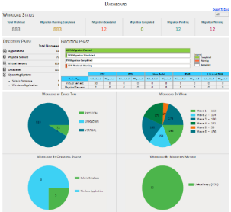
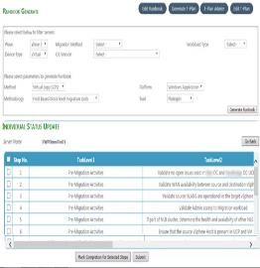
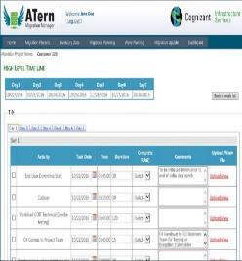
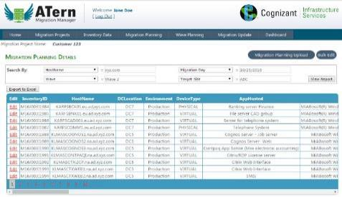
Migration Program Management & Reporting Dashboard
ASSESSMENT
PLAN
MANAGE
MIGRATE
Management Dashboard
Runbook and T-Plan
Migration Scheduling
Single pane of glass for near real-time status of migration projects.
Provides PJI with a detailed view of project status and risk items, if any.
Status can be tracked at an overall Project level or even at a specific Wave level.
Based on the selection of four parameters (Migration Method, Platform, Methodology and Tool), migration steps are standardized and captured in Runbooks.
Tool enables generation of Runbooks for various hosts
T-Plan captures pre-migration steps to be carried out as per Cognizant migration methodology
T-Plan Update (Right)
Ability to upload migration schedule
Ability to phase out migration in various migration waves
Ability to allocate workloads to migration engineers

Slide 44











Cognizant Cloud Operations Governance Framework
ASSESSMENT
PLAN
MANAGE
MIGRATE
Cognizant Will Leverage its Cloud Operation Governance Framework to define Operational Governance for PJI’s
Financial Governance
Service Governance
Technology Governance
Security Governance
Metering & Charge Back
Multi-Landing zone Support
Automation
Security & Compliance
Spend Optimization
Service Catalog
Provisioning and Orchestration
SecDevOps
CI/CD
Governance
Systems Management
Single Pane Of Guard-railed Access
Policy Enforcement / RBAC
Application
Performance
Management
IT Service Management
Self-Service Portals
Cloud Service Brokerage

Slide 45
Indicative Operational Key KPIs
ASSESSMENT
PLAN
MANAGE
MIGRATE
Financial Governance
Technology Governance
Service Governance
Security Governance
KPIs
ROI / Profitability against initial setup
% reduction in Budget vs Actual Spend
Predictable Workload costs
% reduction through CSP negotiation / discount / commitment
Budget Workflows & intelligent gap analysis
% Time Usage of Non-Prod Environments
Cloud Purchase recommendations across multi cloud
Contract Terms Tracking
Cost alerts & cost center chargebacks
Cost comparisons by continuously monitoring Provider pricing
Budget Usage Histogram
%Reduction through cloud migration accelerators
Utilization of resources (on-Demand, RI)
% Right-sized vs. poorly sized
On-Demand vs. Reserved
% of Resources unused / sprawled
KPIs
Architectural enhancements / Ratified landing zones
% Provisioning through self-service
% Provisioning through Blue prints
Patch / Software currency
% DevOps adoption/ Agile application release cycles through DevOps
% Automation vs. % Reduced FTEs
% Cloud native ingestion
Regular Heat reporting w.r.t Policy based compliance
% Provisioning by DevOps
KPIs
All ITSM metrics – Availability, Reliability, Capacity and Performance
RPO / RTO
Application / Resource response/latency times (APM)
% Automatic resolution (Build & Run)
Incident Response Time
Cost per Ticket
Incidents by LoB/Team/Project
Incidents With No Known Resolution
SLA Compliance Ratios
Incidents Resolved Remotely
% failure of backup
KPIs
Security incident metrics
Cost per security incident
Number of users with elevated access level
MTTR/downtime per security incident
Regulatory compliance metrics
Security Exception approvals
Number of policy violations
% systems blocked due to incidents
Security incident metrics
% systems without latest security patches
% systems without end point management tools
% systems with public network access

Slide 46
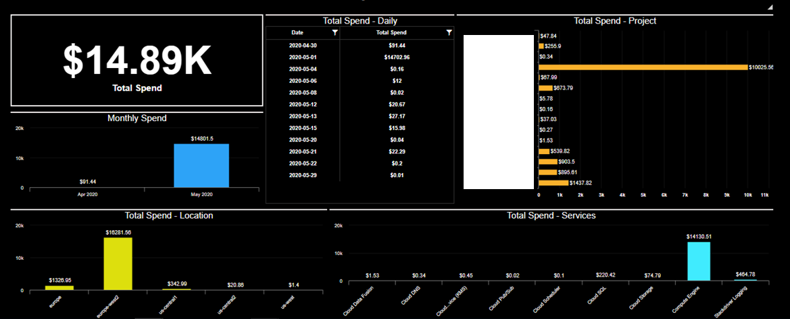
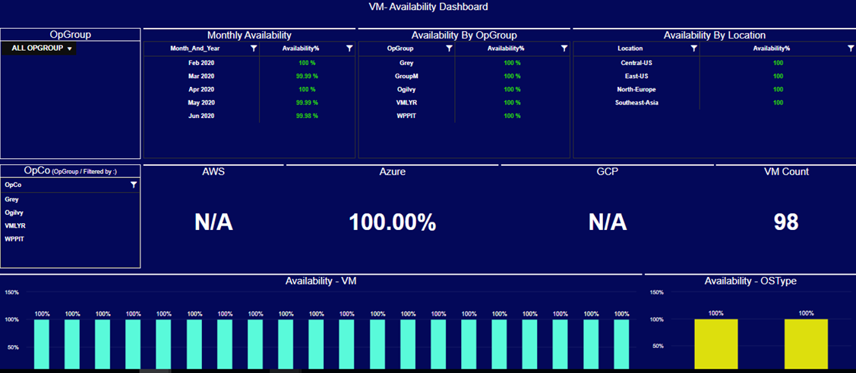
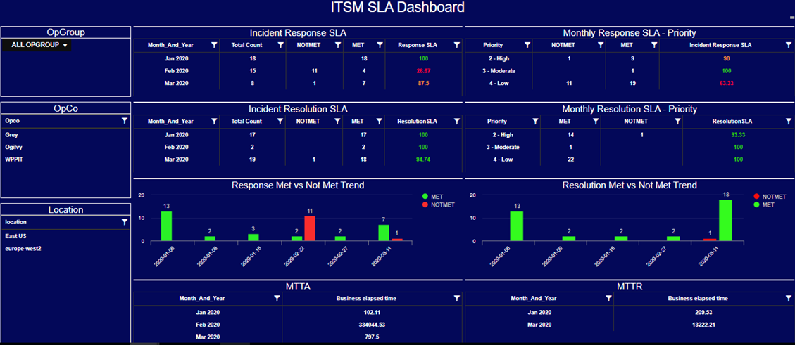
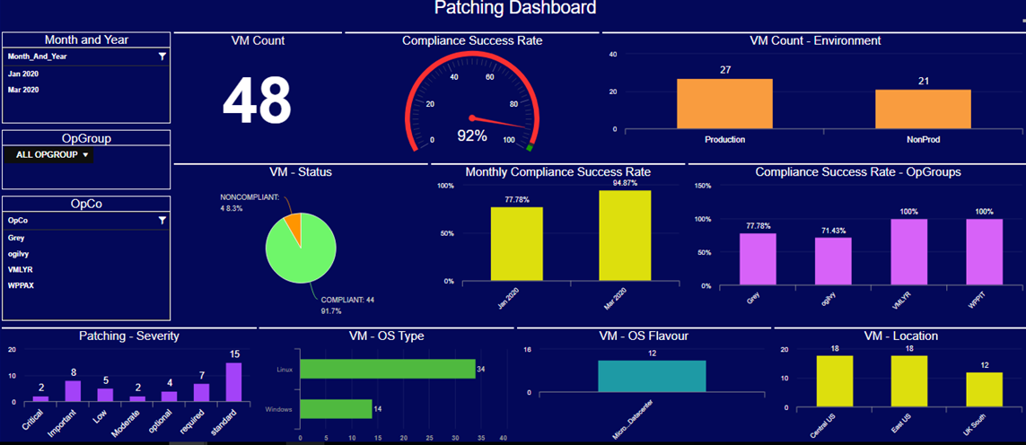
Cloud Governance KPIs - Sample
ASSESSMENT
PLAN
MANAGE
MIGRATE
Financial Governance Dashboard
Technology Governance Dashboard
Service Governance Dashboard
Security Governance Dashboard

Slide 47



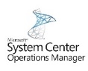




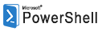






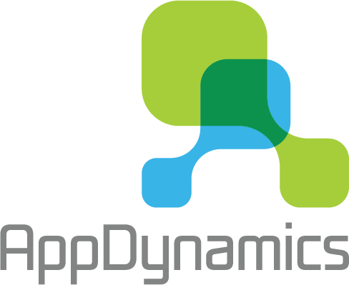
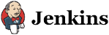





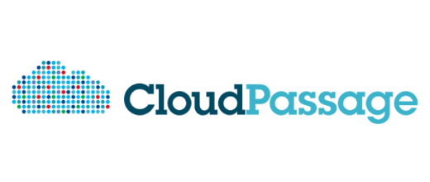





Cognizant Cloud Management Platform – Single Pane of Glass for Multi-Cloud Management
ASSESSMENT
PLAN
MANAGE
MIGRATE
As PJI adopting MULTI-CLOUD strategy, Cognizant will assess the feasibility of using Cloud Management Platform (CMP) to effectively manage multi-cloud using a single pane of glass to do provisioning, cost management, policy management etc.
Spend Management
Service Orchestration
Auto-remediate (AI-enabled)
API Connect
Integrated ITSM
Service Catalogues
Indicative tool sets*
Configuration Mgmt.
Security Ops
Self-service Portal
Performance Analytics
Policy-based
Policies & Remediation
Analytics & Advisory
MAP toolkit
Spend
Management /
Charge back
AI & ML
Self-learning
And Auto-healing
OMS
CMP Platform
Configuration
Management
Provision
& Build
Cloud Native Services
Access control
Compliance Management
Continuous Monitoring & Alerts

Slide 48
Cognizant Enablement Framework – To enable/train PJI on Cloud
ASSESSMENT
PLAN
MANAGE
MIGRATE
Analyze
Plan
Enable
Measure
Analyze existing job roles
Future job role requirements
Identify Gaps and additional enablement requirements
Prepare a compressive report on the current and future state
Get sign off from the state holders
Define enablement plan for each roles and technologies.
Socialize enablement plan with the stake holders
Agree and sign off on the exit criteria and successful completion
Sign off of and publish enablement plan calendar
Deliver the enablement plan
Canned trainings, in-person hands training
Shadow support and enablement
Create and organize training and onboarding repository
Sign off on the completion and exit criteria
Measure the key KPIs for enablement
Targeted trainings in few of the gap areas
Refine the documentation and onboarding process
Validation and sign off

Slide 49
Manage Phase - Deliverables
ASSESSMENT
PLAN
MANAGE
MIGRATE
# | Deliverables | Content
1 | Program Governance | Status report Dashboard with Key details Communication plan Escalation plan
2 | Operation Governance | Target operating model KPIs for Financial, Security, Technology and Service Governance Documentation and knowledgebase
3 | Handover | Reskill / enablement mapping Training plan Documents and knowledgebase
Notes:
Rechange the terms

Slide 50
Migrate Phase – Overall Approach
ASSESSMENT
PLAN
MANAGE
MIGRATE
Factory Migration
Key Workload Migration
Testing and Validation
Factory based migration approach
ArcTern migration tool
Re-host – pipeline
Re-platform pipeline
AIX Migration
Oracle DB migration
Citrix migration
Network appliance migration
Security config. migration
Validation approach
Performance testing
DR testing

Slide 51



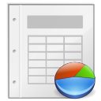

Cognizant Cloud Migration Factory for PJI’s
ASSESSMENT
PLAN
MANAGE
MIGRATE
Cloud Migration Factory
Pre Migration Tasks
Validation
Account
Set Up
Lift &
Shift
Lift &
Optimize
Lift & Transform
Test cases validation
Regulatory Compliance
validation
Workload Mapping
Migration Waves/ Phases
Foundation
Design
Migration Report
Validation & UAT Reports
Migrate & validate
Securely migrate the workload
DevOps Integration
Deploy & Manage applications
Optimize & Handover
Transition to Cloud Operate
Application Functional and
Performance Validation
Security & Compliance
Functional/Non-functional
Requirements
Migration
Plan
Reusable Blueprints
Business Continuity
and DR
Scripts, Processes, Runbooks, Playbooks, SOPs, Tools

Slide 52
Cognizant Cloud Migration Factory – Powered by ArcTern
ASSESSMENT
PLAN
MANAGE
MIGRATE
Assessment / Discovery phase
Schedule Migration
Pre Migration Activities
Post Migration Activity
Reporting
Pre-requisite Checks & Alerts
Run book
Generation
Data import from different sources (MS Excel, ATAvision, etc.)
Upload/ download / edit the inventory data
Project based customization supported
Schedule the migration (date, time, engineer, etc.)
Phase out migration in waves
Change the schedule as needed
Preview Run book
Generate Standardized Run books
Automatically generate T-Plan
Adherence to pre-requisites before actual migration
Auto-alert generation
Customize pre-requisites
Automated standard Run book generation based on parameters selected
Preview and edit the Run book for the parameter selected
Flexibility to customize the Run book
Ability to upload additional standard Run book templates
Update status of inventory when activities performed
Send status updates and alerts to stakeholders
Dashboard to provide client with status of all migration activities
Reporting of Progress Vs Plan, Success rate, Rollbacks, failures and issues/risks
Reporting of Day wise and engineer wise migration status.

Slide 53



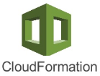

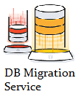
Migration Factory – Re-host/Re-platform Pipeline with End to End Automation
ASSESSMENT
Test Application
Sanity Test, Functional Test, Security / Perf Test
Deliverables
Deployment Architecture
Application Solution Blueprint document
Signed off Blueprint
Upload Tools
Provisioning Tools
Configure
Application Plumbing
PLAN
MANAGE
MIGRATE
Define Deployment Architecture
AWS VM
Import/Export
Azure Site Recovery
Azure Import/ Export
Powershell
ARM
Deliverables
Migrated App on Cloud
Basic Operational Checklist
Security Checklist
Lift & Shift Pipeline
Snapshot
Upload
Provision
Configure
Validation
R3
Rehost using Tools
Stage-Gate Verification
Re-host
After successful cutover, on-prem environments are decommissioned
Repeat for every Move Group
R4
Re-Platform
Provision
Install
Middleware
Migrate
Data
Configure
Validation
Redeploy-Manual
Stage-Gate Verification
Repeat for every Move Group
Provisioning Tools
Install Middleware components & Application
Data Migration Services
SG Verification
Validate at end of each stage
Deliverables
Go Live
Hand-off to support team
Decommission Checklist
Cutover
Native Database
Migration tools
Powershell
ARM
Azure Import/ Export
Cognizant will leverage it’s Cloud Migration Factory powered by ArcTern tool to deliver re-host and re-platform pipeline activities for PJI, by integrating cognizant automation accelerators and other industry tools.

Slide 54



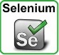
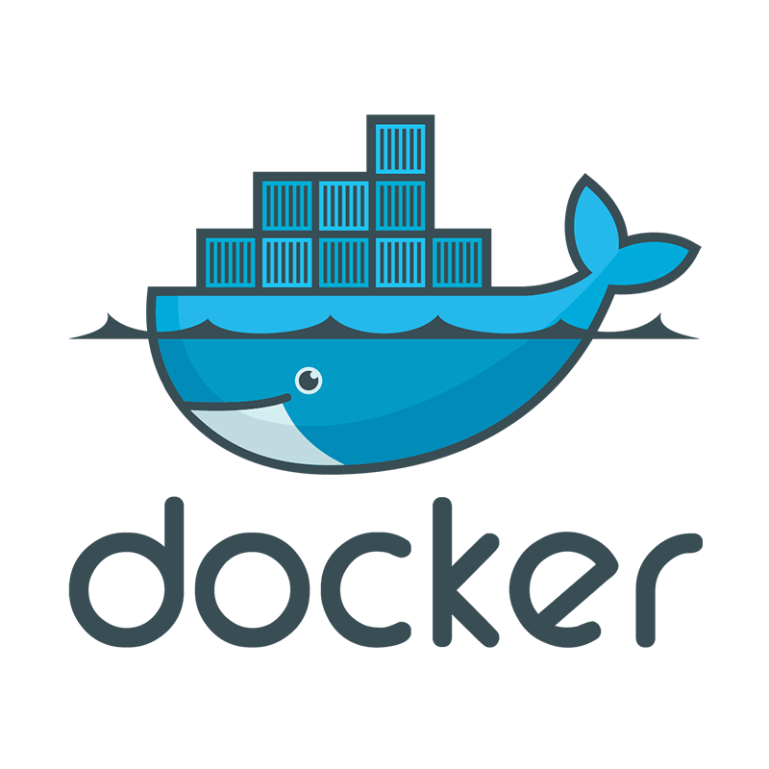
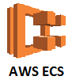
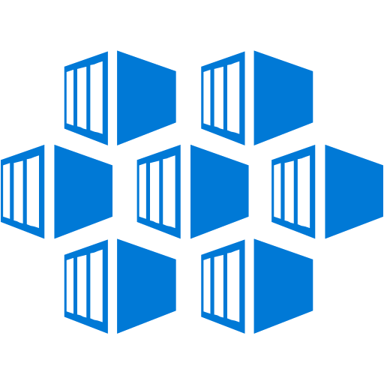
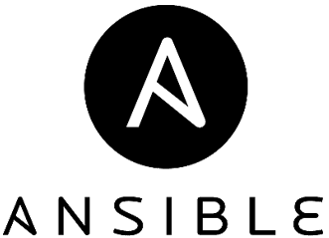

Migration Factory – Re-host/Re-platform Pipeline with End to End Automation
ASSESSMENT
PLAN
MANAGE
MIGRATE
Deploy Tools
Test Automation
Test Application
Sanity Test, Functional Test, Security / Perf Test
Deliverables
Deployment Architecture
Application Solution Blueprint document
Signed off Blueprint
Define Deployment Architecture
VSTS
VSTS
Lift & Optimize Pipeline
Deliverables
Migrated App on Cloud
Basic Operational Checklist
Security Checklist
VM-based Option
Get
Image
Deploy App
Bake Image
Migrate
Data
Provis-ion
Test
Automation
Validate
R3
VM Deploy
Stage-Gate Verification
Re-host
Repeat for every Move Group
R4
After successful cutover, on-prem environments are decommissioned
Container-based Option
Re-Platform
Get OS Image
Packa-ge App
Migrate Data
Dockerize Image
Provis-ion
Test
Automation
Validate
Container Deploy
Stage-Gate Verification
Repeat for every Move Group
Package App
Data Migration Service
Containerization
Provisioning Tools
Deliverables
Go Live
Hand-off to support team
Decommission Checklist
Cutover
Native DB
Migration tools
VSTS
Azure Data Factory
Azure Import/ Export
Azure Container Service
ARM

Slide 55
Cognizant AIX Re-platform Approach
ASSESSMENT
PLAN
MANAGE
MIGRATE
Prepare
Migrate
Validate
Analyze existing AIX environment
Collect functional, non-functional and dependency details
Baseline the compute, storage requirements and define equivalent cloud resources
Baseline performance metrics
Classify the application (custom, COTS etc.)
Identify the AIX hosted database and analyze configuration
Create the RHEL environment in pubic cloud
Configure SSD storage, High availability and DR
Configure/install application on RHEL cloud infrastructure
Port JVM applications to the new RHEL environment
Port and re-compile natives applications in the new RHEL
Configure the database in the target environment
Configure high availability for Oracle database
Run smoke testing to ensure application health
Run environment validation for the migrated app and compare against the baseline metrics
Roll out and cut over to the AIX application
Cognizant will leverage it’s Terraform Iac Generator and AIX Runbook automation scripts to create the RHEL environment in the cloud and deploy the application. Cognizant will leverage its performance testing approach to ensure performance of the migrated applications.
Notes:
RHEL- Red Hat Enterprise Limited

Slide 56
AIX To Linux Migration Strategy
ASSESSMENT
PLAN
MANAGE
MIGRATE
AIX Servers - 85
LPAR Mgmt. (6)
DC – 6
Infra Apps (4)
DC – 3; DR - 1
Manhattan Store App (4)
DC - 4
PeopleSoft WebLogic (27)
DC – 22; DR - 5
Oracle DB (44)
DC – 37; DR - 7
Re-platform to Linux (x86)
Retire
New build with equivalent Infra Apps if required
DR – Replicate
New Build and Install Linux compatible Store App
New Build and App team install Linux compatible WebLogic Application
DR – Replicate
New Build of VM, Oracle / PaaS DB instances
DR – Replicate
Notes:
RHEL- Red Hat Enterprise Limited

Slide 57
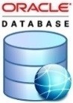
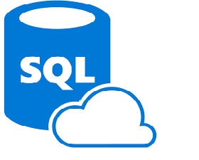
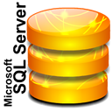
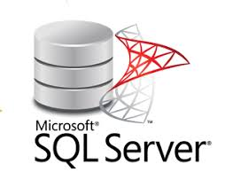
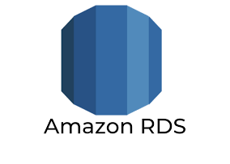
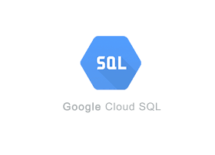
Database Migration Approach
ASSESSMENT
PLAN
MANAGE
MIGRATE
Source Databases
Database Migration
Application Remediation and Validation
Target Databases
Database Schema Migration
Database Remediation's
Database Migration
Application Remediation's
Database Synchronization
Functional Validation
Data Migration (Import/Export)
Performance Validation
Cloud Native Database Migration
Cut-over and roll out
PJI has mentioned in the RFP the 'desire to move away from Oracle DB'. Cognizant will address this during the analysis phase recommend the right DB migration approach, keeping in mind the overall TCO/ROI

Slide 58
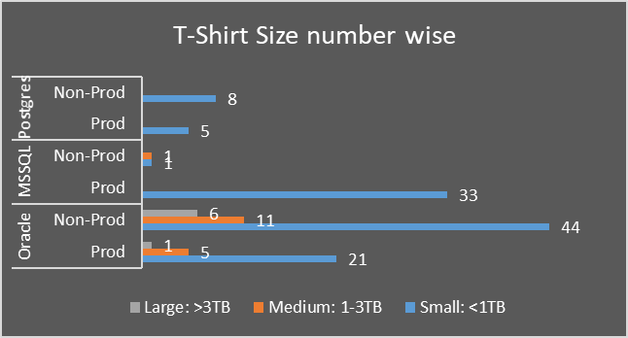
Database Solution Approach To Meet PJI’s Requirements
ASSESSMENT
PLAN
MANAGE
MIGRATE
7 Large sized DB’s are Oracle
17 Medium sized DB’s are 11 Oracle & 1 SQL
112 Small sized DB’s are 65 Oracle, 34 MSSQL & 13 Postgres
On a thorough assessment of the application environment and its dependencies on features and technologies of their underlying databases; landing zones shall be defined and appropriately migrated leveraging the existing tools as much as possible, such as Oracle Dataguard, when Enterprise editions are used.
If..
..Then
Current data model and technological features matches perfectly with Cloud provider’s offerings, without any Re-factoring, Re-architecting or Re-platforming
Most DB’s in PJI may fall in this category
Databases will be migrated without any changes as a part of “Application Move Group” using Cloud Providers Migration services
Current databases primarily uses technological features common to all RDMS vendor, but differ slightly with that of the Cloud providers offerings
Some DB’s on Standard Edition in the Mainstream support of the vendor may fall in this category
Minor Database changes will be made in concurrence with the application’s desired functionality and then migrated as a part of Move group
Current database model needs Re-factoring, Re-Architecting and Re-Platforming based on the Cost-Benefit-Analysis from a larger perspective of Applications above them.
Some of the Oracle databases running on AIX may fall here
Databases will be first upgraded to the Mainstream support and then Platform-Migrated to x86_64 based platform. Finally as a part of Move Group they will be migrated to Cloud Providers services.
Current database model heavily uses proprietary technologies and has a large number of un-resolved dependencies
Some of the Oracle databases running on AIX may fall here
Databases will be retained as-is in an On-Premise Datacenter / IaaS as the case may be

Slide 59



Application Execution Approach – Replatform / Refactor
Plan
Execute
Verify
Replatform & Refactor end state disposition application inventory Application dependencies and other non-functional inputs
Layout the findings and create migration timeline Agree on blocking/pending issues that need to be addressed before the migration or agree on workarounds Create and agree with Papa Johns on the schedule for migration
Migration plan Migration cookbook
Migration Plan and sequence
Deep-dive with Papa John’s application owners on 15-factor issues and recommended remediation Tool based (FEGO) and manual code changes for anti-patterns fixes Code review and Unit test results review
Containerize application (Docker Image etc.) Migrate to cloud environment
Code deployed to DEV / TEST / QA environments
Functional sanity testing of the applications Troubleshoot and remediate any issues reported during functional testing by Papa Johns SMEs Support rollout to production and cut-over DC workload
Handover applications to Papa John’s SMEs for functional testing Production deployed code and cut-over existing DC workload
Inputs
Activities
Deliverables

Slide 60
Environment Validation Approach
ASSESSMENT
PLAN
MANAGE
MIGRATE
Performance Assessment
Identified performance critical Application
Requirements Analysis
Pre Migration
Post Migration on cloud
Activities
Gather Performance and OAT NFR’s for in scope applications with help of PJI team
Draft the brief test plan with all test prerequisites and dependencies ,approach etc.
Determine existing Scripts availability (if any from online flows, Order entry, POBS.GDD etc.)
Performance Environment planning
NFR determination for Manhattan Warehouse Management and web based PeopleSoft implementation layers
Tool access
Test script creation for performance critical application
Test data validation with help of PJI
1 round of Pre Migration Baseline load /SLA definition test
Baseline system health metrics as needed
Smoke test to validate system sanity
1 round of Post Migration Baseline load /SLA validation test
1 round of Stress test for scalability / cloud capacity determination
1 round of Endurance test for memory leak identification
2 round of Failover /Disaster recovery test for identifying service disruption / sudden application Scale up-Scale down impact etc.
Monitor server utilization for Performance monitoring
Deliverables
Performance test results comparable to Per-migration baseline SLA
Cloud Scalability
Identifying performance bottleneck in respect to cloud
Determine NFR for each performance critical application
Baseline performance reports which can be used for comparison after migration.
Define the SLA for different application
Tools
Existing Load Runner /J meter
Load Simulation
Open source Plugins for Chaos simulation
Failover/ Disaster recovery Testing
Azure/AWS/GCP application Insights
Cloud Monitoring
Existing APM tools
On-Premises Monitoring
Performance Center (assuming) Cloud Load Simulation

Slide 61
Schedule, Risk & Assumption

Slide 62

Overall Program Timelines
September’20 |  |  |  | October’20 |  |  |  | November’20 |  |  |  | December’20 |  |  |  | January’21 |  |  |  | February’21 |  |  |  | March’21 |  |  |  | April’21
W1 | W2 | W3 | W4 | W1 | W2 | W3 | W4 | W1 | W2 | W3 | W4 | W1 | W2 | W3 | W4 | W1 | W2 | W3 | W4 | W1 | W2 | W3 | W4 | W1 | W2 | W3 | W4 | W1 | W2 | W3 | W4
Application Blackout time
1. Assessment & Planning
Discovery & Mapping Completed
Migration Planning Completed
Target Landing Zone Finalized
Control Catalog
High Level Implementation Plan
Application & DevOps Assessment Completed
2. Design & Build
Reference Architecture & Design
Cloud Foundation Ready
On-going Design Activities (Tools, Monitoring, DevOps etc.)
Re-platform / Refactor applications to migrate to cloud
LLD Sign-off
3. Migrate & Validate
Migration Wave 1
Wave 2
Wave 3
Wave 4
Ongoing Testing & Validation
Transition & Shadow Support Sign-off
Superbowl Event

Slide 63
Potential Risks & Issues with Multi Cloud implementations
Sub-optimal SLA contracts with Cloud provider leading to poor quality of service
Sub-optimal Enterprise Security design to setup / scale enterprise policies, tools to cover Multi cloud leading to No go implementation
Sub-optimal Hybrid integration design between Multi Cloud and On-premise apps leading to business, data, security issues
Mitigation Strategies for Key Risks as part of Solution architecture
6
2
1
Use SOA patterns, Industry standard Hybrid Integration Platform, connectors, Integration as a service approaches to avoid lock-in, tightly coupled, point to point interfaces
High Impact
1
Defense in depth end to end security strategy addressing IAM, fine grained Role based access, SSO, Endpoint, Apps, Data, networking security controls, Vulnerability mgmt., Intrusion detection/prevention, Data Loss Prevention solutions
2
Sub-optimal Change mgmt. & training to business and IT users (dev, testing, ops) leading to low adoption
Sub-optimal Infra, Networking, Connectivity, Datacenter architecture design leading to availability and latency issues
Sub-optimal Data Migration, Data Governance, On-going data sync setup leading to loss of confidence on system output and UAT
Understand System of Entry / record / reference, master / transaction / historical data, Data volumes/velocity/variety and devise a one time / on going data migration strategy and right tools for same
7
4
3
3
Design Hybrid Infra, Networking, Data center architecture changes. Perform Capacity sizing for Bandwidth. Test and upgrade network, connectivity
Severity of Impact
4
Establish DevOps strategy and implement new tools or extend existing tools for Automated Environment provisioning, Test, Release, Monitoring & management
5
Absence of a well-documented process flow and procedures leading to sub-optimal gap analysis and under estimating customization effort
Sub-optimal Program management not having proper RACI, SLA agreements, stage gate validations with Cloud partners leading to missed expected outcomes
Disjointed set of policies, tools, DevOps setup leading to operational, visibility and Time to market issues
Audit Cloud Vendor security model, certifications, service levels, People practices and establish SLA as part of contracts to ensure compliance and accountability
9
8
5
6
Focus on Holistic Change management / training based on Cloud adoption best practices for different user categories such as Business, IT (Developers, Testing, Ops, Infra) folks.
7
Low Impact
Leverage Agile / Iterative approach for execution to surface risks, issues earlier and communicate/collaborate/manage with the Cloud partner for successful implementation
8
Leverage workshop techniques such as JAD (Joint Application design) to prepare just enough documentation fit for purpose and leverage Reverse engineering tools to gleam business processes, rules if required
Low Probability
Probability of occurrence
High Probability
9

Slide 64
Risks & Mitigation
Perceived Risks | Mitigation Steps | Probability | Impact
Changes to scope of work | Agree on the engagement scope, deliverables and timelines & adhere to strict governance thereby ensuring any activity, deliverable requested outside of scope, timeline changes are treated separate engagements. | High | High
Availability of SME’s stakeholders – during the DD and Execution | Cognizant will work with “ONE TEAM” approach & model. PJI management to ensure availability of SME’s according to shared plan during IST early morning and evening hours given COVID situation and immediate start of program. | High | High
Untimely availability of Network Links: Internet Link between GCP & Azure ISP connectivity between PJI & Public Cloud | Cognizant will provide the network link requirements during assessment phase so that PJI can proactively start procuring the network links from the existing WAN provider and make them available prior to migration | Medium | High Network link unavailability can delay the migration start
Non-compatibility of application, infra etc to chosen cloud | Validate during due-diligence/assess phase which will be migrated to other landing zones for eg: IaaS, Colo, VMC on AWS etc per availability | Medium | Medium
Delay in approvals for Change tickets / Change window restrictions | Any change request raised should be approved within 24 hours and during the planning, migration phases CAB approvals will have to be swift | Medium | High
Onsite / Offshore connectivity - Any issues on this front can affect project timelines | Cognizant will include PJI network SME’s in regular cadence meetings and ensure HA architected connectivity with required bandwidth is provisioned. | Medium | High
Non-availability of necessary hardware, software licenses, Installable etc. | PJI to expedite and ensure timely availability of necessary infrastructure, software & grant access to software like CrowdStrike, LogRhythm etc | Low | High
Change of Migration Approach | As part of Phase 1, all servers are conceived to be Lift and Shift except for AIX PJI not to change Rehost Approach | Medium | High
Change in Wave groups, last minute cancellation of migration | Cognizant will come up with complete communication and detailed plan. Adherence to the same, should be followed to migrate with ease. | Low | High
Support contract not in place, applications that are hardcoded and developer and / or code unavailable | We might have to test and roll back if there are issues post migration. Might have to get extended support and effort planned for migration might have to be increased. | Medium | High

Slide 65
RACI Matrix
Activities | PJI | Cognizant
Project Management | Joint Responsibility
Delivery | C,I | R,A
Cloud Suitability Assessment, Solution Design, Planning & Preparation Move groups, perform security control mapping, current security tool feasibility & BOM | C,I | R,A
Recommend best practices to PJI, Build & Migrate workloads to target, Develop cloud security control catalogue, HLD, LLD, | C,I | R,A
Providing complete Access with full permission to existing source environment for Migration, PJI InfoSec policies, security architecture diagrams, tools inventory, SSO integration details, recent security assessment report. | R,A | C,I
Coordinating with all existing all Suppliers, Stake holders, Partners, Service Providers, ISPs | R,A | C,I
Hardware & Software Licenses | R, A | C,I
Oracle Database Licenses & Middleware Licenses | R,A | C,I
Account, Subscription and Network Infrastructure readiness, Extend current security solutions like CrowdStrike, LogRythm, TripWire etc. | A | R, C,I
Design, build & migration - cloud landscape, security services; security agent rollout | C,I | R,A
HA / DR - Design, build and migration wherever applicable based on design and testing failover & troubleshooting | C,I | R,A
Post Migration testing of Infrastructure and Database and basic infra failover testing for DR workloads | C,I | R,A
Post Migration Functionality Testing of Application and Middleware components | R,A | C,I
User Acceptance Testing | R,A | C,I
Go Live Decision | R,A | C,I
Hyper care, Troubleshoot connectivity issues and configuration changes during application migration | C,I | R,A

Slide 66


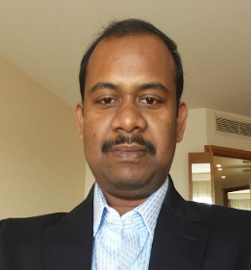

Day 1 Assessment Team
Sujan – Sr. Cloud Migration Lead (Onsite)
Sujan has 20+ years of experience. He has great experience in creating customer Cloud journeys, realization of roadmaps, traditional Cloud migration and green-field cloud implementations. He is also an expert in creating Cloud management, Operations and transformation programs for large customers. He has deep knowledge in traditional as well as Cloud native infrastructure as well as applications. In recent past, he had roles like service delivery lead, Cloud transition Lead and Cloud based CI/CD Program Delivery Champion. He has also extensive expertise in implementing Azure Native Projects (Azure PaaS, AKS, Containerization etc.) using Lean, automation and digital transformational frameworks. He is certified in Azure.
Gopalakrishnan Perumal –Sr. Cloud Architect (Offshore)
Gopal has 15+ years of experience in leading and managing multiple Azure cloud migration programs and support programs. He has also extensive expertise in ASP.NET, HTML5, Web Services, Azure IaaS & PaaS ,Solution Design & Architecture, Effort Estimation, Solution Articulation. He is well acquainted with MVC, MVVM, MVP design pattern and agile methodology.He is certified in ITIL, Microsoft Certified Solutions Developer and Azure. Gopal is the offshore Sr. Cloud Architect.
Debabrata Dey– Application Architect (Offshore)
Debabrata has 16+ years of experience with a track record of leading technical architecture for large and complex technology initiatives. He has extensive expertise in design, development and deployment of large scale Micro Services. He has worked as the technical architect and DevOps enabler for a large 30+ members team to build 200+ micro services on Java, REST, CI-CD, Automated Test, Cloud deployment.
Kingshuk Mukherjee – Performance Test Lead (Offshore)
Kingshuk has 15+ years of performance testing experience. He is specialized in performance Strategy & Transformation, Process improvement, Solutions Integration, Solution Envisioning and Digital Strategy (Cloud, Mobile). He conducted performance test for one NA based leading logistic company, Cognizant identified performance bottleneck and high response time for few scenarios, This issue was resolved by increasing JVM heap size at the application server.

Slide 67
PeopleSoft (Optional)

Slide 68
Our Understanding of PJI’s Requirements
Objective
Perform as-is migration of Papa John’s PeopleSoft environments from On-premise (Louisville/Nashville datacenters) to a Cloud hosted solution. The migration must be completed before/by Jun 2021.
Scope of migration includes – PS Finance, PS HCM, PS Portal and STAT; DEV, TEST and Production regions
Scope of Services
Out of Scope
Text to fill
Configuring/Enabling any new functionality, enhancements or customizations to existing functionality
Upgrade/patching for PeopleTools or underlying Oracle database
Any changes required in 3rd party systems other than as a result of retrofitting due to cloud migration
Resolution to any pre-existing/development issues in PeopleSoft environments
Test script/data creation for SIT/UAT, however, Cognizant will create unit test scripts and support SIT/UAT defects
Performance/Load testing/ Automation testing/Disaster Recovery Testing
Retrofit / Catch-up of ongoing development work to Cloud hosted environments
Decommission of existing lpars
Perform technical assessment to understand and document current PeopleSoft landscape and integrations and scope of migration
Impact assessment on custom/customized objects due to AIX to Linux Re-platforming
PeopleSoft installation and configuration on Cloud VM/RHEL
Lift and shift of PeopleSoft code
Migrate custom objects – custom binaries, server configurations, custom file objects
Retrofit and Unit Testing of PeopleSoft online/file objects impacted due to platform migration/server path hard-coding/syntax changes/database name change
Establish and Unit Test Impacted Integrations – PS to PS, SFTP/IB/DB link/third-party software integrations
Support System Integration Testing and User Acceptance Testing
Cutover - Go-Live and Post Go-Live support

Slide 69
Responsibility Matrix
Key Activities | Primary Owner - CTS | Primary Owner – PJI
Assessment/Discovery | ✓
Planning – Migration Sequence and Solution | ✓
Architecture and Design | ✓
Provide Software Licenses and Software Binary |  | ✓
Server Configuration and Build | ✓
Application Migration | ✓
Application Retrofitting and Interface Remediation | ✓
Updates to upstream/downstream/external 3rd party systems |  | ✓
Unit Testing | ✓
Functional/Systems Integration Testing (SIT) |  | ✓
User Acceptance Testing (UAT) |  | ✓
Support SIT/UAT | ✓
Transition to Production | ✓
Resolve any pre-existing code issues |  | ✓
Decommission Old Hardware |  | ✓

Slide 70
Understanding Peoplesoft Landscape
Application | DEV Region | Test Region | Prod Region | Prod DB Size
PS Fin | 2 Demo, 2 Dev | 2 Test, 1 UAT | 1 Prod | 3.16TB
PS HCM | 1 Demo, 3 Dev | 3 Test | 1 Prod | 890GB
PS Portal | 1 Demo, 1 Dev | 1 Test | 1 Prod | 110GB
STAT | 2 (1 Fin, 1 HCM)
Current OS
OS – AIX v7.2 SP3 (p7 and p9)
Windows
Database
Oracle Database
Single node, Active Dataguard for DR
Interfaces
IB/PS-PS, FTP based; Vertex, ADP; no MQ based integrations
Migration Tools Used
STAT – for Fin, HCM (PT 8.56)
Cobol Compiler
Yes
Load Balancer
Netscalar
Note: Information captured here is based on DC inventory and other information shared by PJI during QnA session

Slide 71
Assumptions and Dependencies
Assumptions on Existing Landscape
This is an as-is migration so no new images (PUM) or functionality will be added
PeopleTools version is 8.55 and Oracle database v12 or higher and will not require upgrade during platform/cloud migration
Middleware -
PS environments are hosted on Weblogic web server, there is no reverse proxy server
PS App/PRCS are mainly hosted on AIX platform and the PSNT process scheduler is hosted on Windows platform
Middleware complexity in Production region is medium – ~2-4 web/app non-clustered domains; ~ 2-3 process schedulers each for Fin, HCM and Portal
PS CRM application is not considered in scope with the assumption that it will be moved to Salesforce
Single sign-on based authentication with MS Active Directory
In the absence of any information of the integrated applications at this stage, build/unit test effort has been capped at ~750 hours. Efforts and schedule will be re-validated based on discovery during assessment, any changes requiring additional efforts will be handled through appropriate change control process.
Retrofitting/Unit Testing of any interfaces (or customizations) in PS apps that require a change due to the platform change
Check printer validations and modifications to layouts (if needed) – It is assumed that the current check printer will be reinstalled in the new platform
Assumptions on Infrastructure Availability -
All required licenses and binaries for installing PeopleTools and related components will be made available by PJI
Onshore/Offshore connectivity and access to be established for PeopleSoft resources in Week 1 (joint responsibility of Cognizant and PJI)
Any issues (performance or otherwise) that are specific to network / underlying infrastructure / database, will be owned by Cognizant Infra team
Testing –
Unit Testing – Will include basic environment checkout/operability check from online/middleware standpoint, testing of retrofitted objects only. It will not include end-to-end testing.
Any existing test cases will be leveraged, and additional test cases will be identified to complete unit testing
User Acceptance/Functional Testing – will be performed by business users; Cognizant will provide support on analyzing defects and provide technical fixes
SIT testing phase is assumed to be ~4weeks and UAT is considered ~3weeks for each Fin, HCM and Portal. Any change to the assumed timelines will result in an impact to the overall schedule and cost which will be handled through appropriate change control mechanism.
Dependencies -
Papa John’s SMEs will be available to provide information to Cognizant team as required for the project
Availability of Rimini Street vendor support for Oracle PeopleSoft application product bugs during/after migration
Remediation of any to upstream and/or down stream systems including modifications to web services outside of PeopleSoft will be performed by Papa John’s
PS Migration / build will start only after Cloud foundation is ready

Slide 72
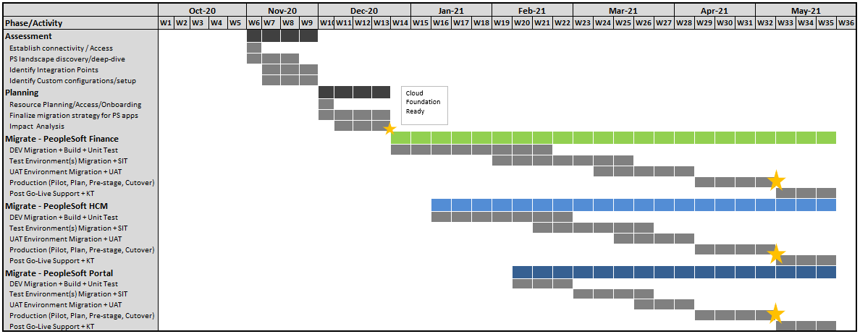
Peoplesoft Migration Timelines
PS Fin Environments : PSFSM01 PSFSM05 PSFSD01 PSFSD02 FS856PS1 PSFST01 PSFST02 PSFSUAT PSFSP01
PS HCM Environments: PSHRM01 PSHRD01 PSHRD02 PSHRD03 HR856PS1 PSHRT01 PSHRT02 PSHRT03 PSHRP01
PS Portal Environments: PSPTLM02 PSPTLD02 PSPTLT01 PSPTLP01

Slide 73
Peoplesoft Migration – High Level Steps
ASSESS
PLAN
MIGRATE
Phases/Activities
Establish connectivity
PS application landscape discovery
Environments
Architecture / components
3rd party software/versions
Compatibility check
Identify Integration Points
Identify Custom configurations/cron
Identify hard-coded host/db names in code
Identify ports, IP’s in use
Database backup/refresh models
Application Filesystem details
Determine Source to Target mapping and Migration steps
Finalize migration roadmap and sequence for PS apps
Impact Analysis and Design
Strategy for inflight/ongoing DEV work
Finalize Testing Approach
Finalize Success/Exit Criteria
Resource Planning/Access/Onboarding
Locate installable and licenses
Identify key stakeholders
Establish connect with Rimini Street vendor
Revisit timelines and estimates
Identify preferred go-live time based on key business events
Design and Build
Connectivity/operational readiness check for Cloud VM
PS Installation on Cloud (RHEL / Win)
Database Migration – DEV region
Lift n shift of Custom file objects/configurations/user generated reports
Integration setup – IB/FTP/3rd party
Setup - AD/STAT/Vertex/ADP/Check printer, UPK (as applicable)
SFTP Server interface folder mapping
Build / Retrofit for Platform changes,
Unit Testing
Catch-Up for Ongoing Development
Testing
Migrate Test DBs/Environment(s)
Integration setup/Migrate retrofit code
System / Integration Testing
User Acceptance Testing
Support Testing and Obtain Sign-offs
Production
Pilot or Dry-run
Pre-staging work - Production
Migrate Production DB/Environment
Migrate DR DB/Environment
Post Go-Live Support
Knowledge Transfer
Deliverables
PS application landscape as-is inventory
Custom configuration details
DB inventory
Firewall requirements
Migration strategy
Project plan/timelines
Technical design for impacted objects
Unit Test Plan and Results
DEV Environments Migrated to Cloud
SIT and UAT defect reports
TEST/PROD Environments Migrated to Cloud
Post-go-live defect log
Updated Architecture diagrams
MANAGE
Track Project Timelines and Status Reporting
Track and oversee deliverables for PS migration path
Resource/team management
Risk assessment

Slide 74

Peoplesoft Migration – Production Go-Live Workflow
On-premise
PeopleSoft ERP
Web + App + Batch
Install/Configure Web, App, PRCS Domains - Pre-stage in advance to reduce cutover time
PJI Specific Custom Configurations + Custom File Objects + Report Repository
Pre-stage 1week prior to reduce downtime
Migrate delta files/reports during cutover
PeopleSoft ERP (Fin/HCM/Portal)
Oracle Database (Code + Metadata)
Export-Import during Pilot for indicative timings
Full-backup export/import during cutover
Pre-Cutover Checks
Migration
Post Migration Sanity
Close all business/batch transactions
Post all reports
IB pause
PS Audit reports
Table Counts
Control queries
Active dataguard off
DB – Read-only mode
Filesystem/Source-Target connectivity pre-checks
Database Migration
Filesystem Migration
Apply Custom configurations/files/reports
Migrate remediated PS objects
Configure/remediate custom cron/monitoring scripts
Configure application for database connectivity
Configure application for load balancer/SSL handling
Integration updates
Remediate Impacted Application Objects
Table counts / SYS / DDD Audits
Cache clear/rebuild
VERSION
Ping tests
Sample Reports
IB/FTP/AD/STAT/Vertex/ADP/Check printer smoke test
Enable DB backup/replication
File system mount points/file counts

Slide 75
Pricing Assumptions
Pricing Assumptions
Price mentioned above is on Fixed Bid basis for the scope mentioned in this proposal
Efforts are based on certain assumptions for the existing application versions/landscape. Cognizant will revisit schedule and pricing related estimate at the end of Assessment phase. Any change in technology understanding/scope determined based on Assessment will be handled via change control procedure and may result in changes to the effort and cost estimate
The pricing is for migration services to be provided by Cognizant. It does not include any SW/HW cost
Note: Pricing provided in the Pricing slide (101)

Slide 76
Cognizant Qualification

Slide 77


About Cognizant
Founded
1994
(Nasdaq: CTSH)
Global
Headquarters
Teaneck, New Jersey
290+
Global Offices
177
Global Fortune 500 Clients
Revenue
$16.8B in FY 2019 (up 4.1% YoY)
42% Digital Revenue Share
of total Q2’20 revenue
Revenue mix
NA: 75.1%
RoW: 24.9%
281,200
Employees
Accolades & Recognitions
#194
#533
Leader in Magic Quadrant for Public Cloud Infrastructure (2020)
On 2020 Fortune 500
On Forbes Global 2000 for 2020
12 Years
#63
#461
One of Fortune’s Most Admired Companies
On Forbes Top 100 Digital Companies for 2019
On Forbes America’s Best Employers 2019

Slide 78









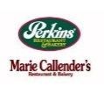














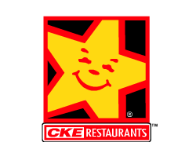






Cognizant’s Restaurant & Food Service Practice Overview
Ecommerce
CUSTOMER FACING
Contact Center
Inventory
Management
BACK OF HOUSE
35K
POS
Product
Implementation
Labor
Management
Stores Supported
CRM
CORPORATE SYSTEM
Production
Planning
Finance &
Accounting
Operational
Reporting
~135K
DWBI
Vendor
Management
IT Infrastructure Services
OTHERS
POS Systems supported
Restaurant
Development
Human Resource
Management
BPS Services
Legal
Compliance
Food Cost
System
Compliance Reporting
2000+
Experts
19+ Years in Restaurant Space | Only Tier 1 IT and BPS services company with special focus on Restaurants

Slide 79
Cognizant Cloud Services - Overview
Proven Competence and Experience
Labs/R&D
Seamlessly integrated to Cognizant’s technology and consulting services lines: across app and infrastructure
Dedicated Cloud centers of excellence; Infrastructure-as-a-code labs; Digital collaboratory
Comprehensive Hybrid Cloud Platform Choices
End-to-end Services
Advisory; build; migration; app modernization; managed services for public, private and hybrid cloud
Private cloud at customer data center: VMware, Open Stack, Cloud Foundry
Hosted private cloud at partner/Cognizant data center: VMware, Open Stack, Cloud Foundry
Multi-tenant/dedicated cloud at hyper scale data center: AWS, Azure, IBM, GCP
Cognizant Cloud Services
Unique IP for Cloud Transformation
Cloud Steps Transformation Framework; Cloud360; On Target, CloudTrust
Platforms Delivered ‘as-a-service’ over Cloud
TriZetto; Smart Trials; assetSERV; OrderServ; Big Decisions
Strategic Partnerships
Delivery Centers: North America, UK, Europe, APAC, LATAM
AWS Premier Consulting Partner & Managed Service Partner; Microsoft Gold Cloud Platform Partner; Pivotal Cloud Foundry Global System Integrator Partner
IBM, VMware, SAP, Oracle, Rackspace, RISC Networks, Racemi, Cirba, BMC, Oracle, NetApp
Comprehensive Cloud Solution Offerings
4000+ Cloud Professionals
Data Center Migration, Agile Engineering Environments, Resilient Web Platform, Intelligent Data Platform, Enterprise Apps on Cloud, Workplace Cloud Solutions.
350+ Active Clients

Slide 80








Strategic Partnership with all leading Public Cloud providers
Longest Standing Global Partner since 2008 (Top 3 GSI)
AWS Premium Consulting
AWS Managed Services Program
AWS MAP (Top 2 GSI’s)
AWS Service Delivery Partner
2800+ certified (4000+ trained)
300+ AWS clients (100+ Managed)
Capabilities: Managed Services, Migration, Big Data/Analytics, DevOps, Workspaces
Platinum partner for Azure (Top 3 SI)
Frank and Satya sponsored Project Everest
Managed Expert Azure Managed Services (MSP), O365 Fast Track and Microsoft CSP program
1500+ trained professionals, 900+ certified
75+ clients transformed to Azure platform
Capabilities: Digital Workplace, Data &AI and Enterprise (DC) transformation
Data Infrastructure Partner of the Year – FY17 & FY18
Top 5 Strategic GSI Partner with Google Cloud (Premier Tier)
Top 2 GSI Partner with Apigee
Certified Advanced Global System Integrator for Cloud
Executive leadership sponsorship towards enhancing joint value proposition for common clients
75+ certified (400+) trained professionals
10+ customers
Partnership with Oracle
Worked together on several engagements and proof-of-concepts delivered
Specialist knowledge for architecting technical solutions Access to experienced resources, accelerators and compliant solutions and Alibaba Cloud
Cognizant-Microsoft-Oracle cloud Partnership
Cognizant IP/Accelerators
Cognizant Cloud Steps
Transformation Framework
Cognizant Cloud360
Service Orchestration & Governance Platform
Cognizant Cloud Speed
Digital Application Delivery Fabric
Cognizant Cloud Trust
Security and Compliance Framework
Notes:
Refresh with newest certification.
Get : the Aws partner deck. What we Consume, Spend and Nithin and SI.

Slide 81





Analyst Recognitions
JUNE
2020
JUNE
2018
JU3Y
2018
SEPTEMBER
2018
SEPTEMBER
2018
DECEMBER
2018
DECEMBER
2018
DECEMBER
2018
Featured as
‘Leader’ in Gartner’s Magic Quadrant for DCO and Hybrid Infrastructure Managed Services Report 2018 for North America ;
--
Featured as a ‘Niche Player’ in Magic Quadrant Report for DCO /HIMS 2018, Europe
Featured as
a ‘STAR Performer’ in the Major Contender Category in Everest's PEAK MatrixTM for Digital Workplace Services
Featured as
‘Major Contender’
in Everest's PEAK MatrixTM
for IT Infrastructure Services Automation
Featured as #3 IT Service Provider globally by HFS in Top 10 Infrastructure & Enterprise Cloud Services 2018 Report
Featured as a ‘Leader’ in Managed Digital Workplace Services and Cloud-Based VDI Services quadrants in the ISG Provider Lens Digital Workplace of the Future 2019 Global Report
Featured as ‘Leader’ in Everest Peak Matrix for Cloud Enablement Services 2018 Report
Featured as ‘Leader’ in US, Global, UK & ANZ in Cloud Transformation/ Operation Services & XaaS ISG Provider Lens study
Featured as a ‘Leader’ in Avasant global Hybrid Enterprise Cloud Services RadarView 2018 report

Slide 82
General Requirements

Slide 83






Cognizant Azure Practice
MOMENTUM
Building Domain Knowledge and Competitive Advantage
50+
Transformational Blueprints
1500+
Certified Azure Professional
80+
Managed Clients
15000+ Microsoft Practitioners
110+
Customers to Azure
Proven Partnership
Strategic Liaisons
Mature, long term partnership with Microsoft enabled by strategic projects (Project Everest) and Go To Market initiatives
Microsoft Partner Network & Dedicated GSI Support
Certification of Distinction by Azure for crossing 350+ Certifications
Dedicated Microsoft Pre-sales Support
Dedicated GSI support for Solution implementation
Azure Offerings
Breadth of Cloud Support
Cloud Consult – Cloud strategy & roadmap, platform selection (public cloud or Azure Stack), assessment, security and cloud operations model
Cloud Migrate - Application lift and shift, re-platform, re-engineer, cloud native app dev and provisioning & automation
Cloud Operate – CI/CD DevOps, workspaces, enterprise apps, managed databases
Workplace cloud solutions, enterprise apps on cloud, agile engineering environments, resilient web platforms, intelligent data platforms
Accelerators & Toolkits
Key Enabling Technology
Cognizant Cloud Steps Migration Framework:
Cognizant Cloud Ops – Intelligent Cloud Operations Fabric
Cognizant Cloud Trust – continuous compliance in cloud
Cognizant HiveCenter – AI led cloud management and orchestration platform
Cognizant Arc-Tern – cloud reporting dashboard
Global Migration Factory
Solutions & Platforms
Empowering Users
TriZetto products – FACETS, QNXT and TranZform
Hybrid Cloud for Healthcare
Digital Platforms on Azure
Business Platforms
Business Applications
Cognizant HiveCenter – Enterprise-class IT automation ‘hyperplatform’
Cognizant assetServ – Digital Asset Management Solutions

Slide 84

Cognizant + Microsoft Joint Service Offerings
Hybrid Identity Solution, Identity Life cycle Provisioning, Unified multi channel authentication, SSO etc.,
Data discovery, Data classification and data protection solutions
Azure Information Protection
Azure
Active Directory
Cognizant
Security
Security operation, round-the-clock monitoring, lifecycle management and incident investigation etc.,
Azure
Sentinel
Azure MCAS – Joint solution with Zscaler for cloud native and cloud ready APPS to Azure using Zscaler Private access (ZPA) and Zscaler Internet access (ZIA)
Notes:
Available to sell now – for immediate opportunities contact Bettina
Cognizant pricing will be available shortly, Azure pricing under: https://azure.microsoft.com/en-us/pricing/
One-pagers available today, detailed service description in progress
Available global for AD, AIP and Sentinel

Slide 85

Cognizant AWS Practice
MOMENTUM
Building Domain Knowledge and Competitive Advantage
70+
Transformational Blueprints
550+
Pro Certs
100+
Managed Clients
6500+
Certified AWS Professional
10000+
Trained AWS Practitioners
350+
Customers to AWS
Proven Partnership
Strategic Liaisons
Longest standing global partner since 2008
2nd largest GSI across the globe (by AWS mindshare)
Joint Executive Leadership Sponsorship
Dedicated team driving partnership: 100+ GTM, Consultants, Solution Architects, Delivery
Center of Excellence (CoE) Collaboration
AWS Offerings
Breadth of Cloud Support
Cloud Consult – strategy & roadmap, platform selection, assessment, security and cloud operations model
Cloud Migrate - application lift and shit, re-platform, re-engineer, cloud native app dev and provisioning & automation
Cloud Operate – CI/CD DevOps, workspaces, E&T apps, managed databases
AWS Factory based Delivery and Managed Services
Accelerators & Toolkits
Key Enabling Technology
Cognizant Cloud Steps Migration Framework:
Cognizant Cloud Trust – continuous compliance in cloud
Cognizant HiveCenter – AI led cloud management and orchestration platform
Cognizant Arc-Tern – cloud reporting dashboard
Global Migration Factory
Solutions & Platforms
Empowering Users
BigDecisions – Business Solutions Platform
Cognizant HiveCenter – Enterprise-class cloud management ‘hyperplatform’
Cognizant assetServ – Digital Asset Management Solutions
Arc Term – Cloud Migration Management
Read more on our cloud offerings: Driving Digital Experience Through Cloud

Slide 86



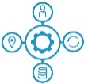



Cognizant Google Cloud Practice
Assured Business Continuity
Enabling Cognitive, Efficient & Collaborative Enterprise
25+
Joint Customers
1000+
Trained Professionals
400+
Google Certified Professionals
Proven Partnership
Google Cloud Partner teams
GCP IaaS/PaaS COE team
GCP Data & Analytics Practices
Cloud Driven Enterprise Modernization: Our Offerings
Cloud Advisory
Develop and define Cloud computing strategy
Structure the cloud journey using our expertise from 300+ engagements for several enterprises
Cloud Migrate
Rehost, Refactor, Replatform, Rearchitect to cloud
Reduce cost of apps by 20 - 40% using Scalable and repeatable migration methodologies
Cloud Operations
AI based, Cloud Managed Services
Resolve upto 40% of tickets faster through automation and KEDBs
Cloud Security
Comprehensive Compliance and Security solutions for hybrid cloud
Enable Intrinsic platform security and protection to meet industry regulations
Containerized Infra
Increased velocity for Cloud Native apps
Improve platform resiliency to handle 10x more traffic during the peak season
DevSecOps Pipelines
Automated Application and Infrastructure deployments
Achieve upto 8x reduction in the time taken for application deployments

Slide 87





Hybrid cloud approach for Digital Transformation
Leading Energy and Utility Company
CHALLENGE
SOLUTION
OUTCOME
Spiraling cost and increasing security concerns with legacy and complex IT systems
Competitive and fast moving market demanding agility
Ambitious goal to be a digital company
Need for scalable and agile infrastructure
Establish cloud foundation for Digital Operations
Improve collaboration and business Agility
Digital-ready hybrid cloud platform: Most of the COTS Applications were migrated to Azure, certain SAP, linked apps and some Oracle Applications were moved to Private Cloud
Evergreen approach for up-to-date platforms with the latest versions of software and firmware
80% applications modernized with Re-host and Re-platform approach
Agile and scum methodology for delivery
30+ security controls with tools like Palo Alto, Qualys Guard, DUO, CyberArk and IBM Qradar were leveraged
25% Annual TCO reduction
Infra provisioning from weeks to ~1 hour
30% reduction in batch processing time
Improved customer experience with process simplification
Faster product launches
Top
Notes:
Centrica

Slide 88


Azure for Digital Readiness and Standardization
Leading banking and financial services company
CHALLENGE
SOLUTION
OUTCOME
Client had scattered technology footprint across prod-non prod, which led to huge management and operational overheads
Legacy applications were posing challenges in embracing latest security standards
Client had aspiration to stay ahead in technology space by adopting Nextgen technologies
Migrated 800+ applications to private clouds across Azure Pack, OpenStack and Cloud Foundry with security compliance validation
Adopted multiple approaches for migration as suitable: Rehost for applications on private cloud and Refactor or Remediate for PaaS or IaaS migrations
Leveraged Cloud Management Platform (CMP), to abstract dependencies and address application onboarding pre-requisites​
Automated infrastructure provisioning and leveraged automation scripts and tools for migration
Defined governance framework and standardized processes for multi cloud support
Delivered an innovative Migration Tracker Solution to offer both bird’s eye view and detailed view of each application’s progress
Scalable, standard and secure architecture with high availability
Lowered TCO by reducing infrastructure footprint by 25%
20% reduction in migration cost with cloud migration consulting​
Improved productivity by 25%​ with Migration Tracker Solution
Reduced cloud ramp up time by 35%
Faster time to market
Top
Notes:
Wells Fargo

Slide 89


Azure PaaS for Customer Delight & Compliance
Leading International chain of convenience stores
CHALLENGE
SOLUTION
OUTCOME
No single trustworthy data source for nutrition fact panel details
No single pane of truth available for store location, store operating hours, store managers
No single communication medium to acquire data from vendors
Multiple traditional database systems like Mainframe, SQL Servers, MS Excel with limited data available
FDA and USDA regulations demanded food and drug data accuracy
Nutrition Master System: Delivered PaaS solution in Azure which can consume data from different vendors through different communication medium based on the vendor choice,
Collect data either through Files or through API or PowerShell script which runs on vendor machines which can transfer data to Azure Service Bus.
Location Master System: Built a PaaS solution with different database adapters to query data from different source systems running on a timely basis and push data to Azure Service bus.
API’s (Azure API gateway) were built on solution to expose data to any client system (mobile Apps) and to be able to stream data through Azure Event Hubs.
Single source master data system for nutrition fact, store details and prices complying with government regulations
Additional feature on mobile app to delight customers by displaying nutrition fact panel data
Plans to use Nutrition data and charge Tax (Sugar Tax) based on the composition of items
Feature to share real time fuel pricing through external partner, which helped in increasing profits
Top
Notes:
Seven-11

Slide 90


Azure for Customer Delight & Digital Readiness
Leading US based beauty retailer
CHALLENGE
SOLUTION
OUTCOME
Huge operational cost of running inventory and point of sale systems across 6000+ global stores on legacy and outdated software
Client wanted to replace legacy retail systems with Nextgen technology for better customer experience and streamlined inventory management
Customer also wanted to ensure the infrastructure is reliable, highly available and perform at optimal level
Retail application transformation through agile approach followed to ensure hosting platform was implemented iteratively in co-ordination across the organization
Designed and built infrastructure on Microsoft Azure and provided fully managed services on Azure
Optimal server size and scalability for application load provided
Used the azure application gateway to load balance the application load with high availability
Automated build scripts were created to provision the infrastructure for different environments to minimize the turnaround time
Quick technology transformation to achieve Digital POS Platform
Scalable architecture and high availability
Reduced TCO and Faster time to market
Reduced batch processing time by 40%
POS: Point of Sale
Top
Notes:
Sally Beauty

Slide 91


Data Center transformation to AWS Cloud
Leading US Media Conglomerate (IME; US)
CHALLENGE
SOLUTION
OUTCOME
Consolidation of distributed DC footprint to Cloud
Large Infrastructure Landscape of 10 Data Centre with 1200 Servers and 500+ Applications. The business incurred huge costs simply to maintain a network that was as inefficient as it was complicated.
Introduce Standardization of Infra software and processes
Achieve overall cost savings
Data collection & analysis of the current IT landscape across people, process, and technology
AHP application portfolio tooling to provide prioritized application migration candidates for cloud
Governance framework for heterogeneous cloud platform support
Cloud playbook providing applications with on-ramp to cloud
Cloud reference architecture and service capability mapping
TCO calculation to compare the benefits of cloud with on-premise
Defined migration plan move groups
Consolidation of 10 distributed DC to AWS and Co-location facility
Introduced Scalability and elasticity for applications
Faster IT response times to Business initiatives with auto provisioning
Lower cost of IT Infrastructure & operations with On-demand usage
Repeatable and governed operations processes
Improved SLAs and service quality
TECHNOLOGY STACK:AWS IaaS / PaaS, Private cloud Colocation
Notes:
Sally Beauty

Slide 92

Workload Migration to GCP
Tools and Technologies
CloudEndure is a built-in functionality in GCP console.
Customer Challenges
Enterprises planning to migrate their re-host (Lift-and-Shift) type of workloads to Cloud usually spent significant amount of time and effort in vendor identification, picking the right solution and its testing. Also, in a few cases multiple solutions may be required to cover all the use cases or the required features.
Benefits/Differentiators
Migrate up to 10,000 licenses for Free
Zero Downtime
No need to setup or configure any dedicated server
Ease of migration from On-Premise to Cloud or Cloud-to-Cloud
About the Service
Workload Migration to GCP service from Cognizant helps enterprises to move their workloads to Google Cloud Platform seamlessly using an integrated tool known as CloudEndure. This service focuses on migrating “Lift & Shift” type of workloads from On-Premise to Cloud or between different Cloud Service Providers.

Slide 93



Customer References
SL No. | ACCOUNT | DESCRIPTION | POC
1 |  | Data center migration of 480+ applications and 4500 servers to Azure, AWS and CoLo | Vivek Kumar Vivek1.Kumar1@cognizant.com
2 |  | Data center migration of ore than 250+ applications and 1600+ servers to Azure | Cham Silvy Silvy.Cham@cognizant.com
3 |  | Migration of Oracle POS and JDA (600+ servers) supply chain system to Azure and delivering it as a managed services | Cham Silvy Silvy.Cham@cognizant.com

Slide 94
Financial & Business Disputes

Slide 95

Financials & Business Disputes
2019 Financials
Revenue: $16.8Bn (4.1% YoY)
Income from Operations: 2.4B
(-12.4% YoY)
Net Income: $1.8Bn (-12.3% YoY)
Sustained Growth
Pending Litigations
Cognizant is restricted from providing certain sensitive business information that is not publicly disclosed. we are involved in various claims and legal actions arising in the ordinary course of business. Material litigations are disclosed in Cognizant’s public filings as and to the extent required by applicable securities laws, rules and regulations.
To the best of its knowledge, Cognizant does not presently have and has not in the past five (5) years had any material pending lawsuits that would preclude Cognizant from performing its obligations in connection with services contemplated under this RFP. Cognizant has not been involved in any bankruptcy proceedings.
2018 Financials
Revenue: $16.1Bn (8.9% YoY)
Income from Operations: 2.8B (12.9% YoY)
Net Income: $2.1Bn (39.7% YoY)
$2.6B
$2.1B
Capital return through dividends and share purchases
Free cash flow
Please click on the link to access Cognizant’s Financial Statement
https://investors.cognizant.com | www.sec.gov

Slide 96
Support Model

Slide 97
Cognizant Managed Services – Service Level Agreement
Offerings | Standard | Professional | Premium
Support | 24x7 – L1 | 24x7 – L1 / L2 / L3 | 24x7 – L1 / L2 / L3
Response SLA
Critical | - | 1 Hour | 30 Mins
Severe | 4 Hours | 2 Hours | 1 Hour
Standard | 24 Hours | 4 Hours | 2 Hours
Resolution SLA
Critical | - | 4 Hours | 4 Hours
Severe | 24 Hours | 24 Hours | 24 Hours
Standard | 48 Hours | 48 Hours | 48 Hours

Slide 98
RACI for Cloud
IaaS, PaaS
SaaS
 | Service | Cloud Provider (IaaS, PaaS) | Service Provider | Customer |  | SaaS provider | Service Provider | Business User
SPECIALIST SERVICES | UNKNOWN INCIDENT RESOLUTION | A | R | I |  | A | R A | I
 | AD HOC SERVICE REQUESTS FULFILLMENT | C | R A | I |  | C | R A | I
 | APPLICATION PROBLEM MANAGEMENT | C | R A | I |  | A | R C | I
 | OPERATIONAL CHANGE MANAGEMENT | C | R A | I |  | C | R A | I
 | RELEASE ACCEPTANCE SERVICES | C | R A | I |  | C | R A | I
 | APPLICATION CONTINUITY & RESILIENCY SUPPORT | A | R C | I |  | R A | C | I
OPERATIONAL SERVICES | APPLICATION MONITORING | C | R A | I |  | R A | C | I
 | BATCH MONITORING | C | R A | I |  | R A | C | I
 | BATCH SCHEDULING / EXECUTION | C | R A | I |  | C | R A | I
 | KNOWN ERRORS RESOLUTION | C | R A | I |  | C | R A | I
 | STANDARD SERVICE REQUESTS FULFILLMENT | C | R A | I |  | C | R A | I
 | OUTAGE & MEDIATOR SUPPORT | A | R C | I |  | R A | C | I
Services

Slide 99
Support Coverage
24 x 7 – 3 Shifts
EST | 0:00 | 1:00 | 2:00 | 3:00 | 4:00 | 5:00 | 6:00 | 7:00 | 8:00 | 9:00 | 10:00 | 11:00 | 12:00 | 13:00 | 14:00 | 15:00 | 16:00 | 17:00 | 18:00 | 19:00 | 20:00 | 21:00 | 22:00 | 23:00
India IST | 10:30 | 11:30 | 12:30 | 13:30 | 14:30 | 15:30 | 16:30 | 17:30 | 18:30 | 19:30 | 20:30 | 21:30 | 22:30 | 23:30 | 0:30 | 1:30 | 2:30 | 3:30 | 4:30 | 5:30 | 6:30 | 7:30 | 8:30 | 9:30
Onsite Shift
OffShore Shift 1
Offshore Shift 2
Offshore Shift 3

Slide 100
PRICING

Slide 101
Pricing Summary
Phase | Price | Remarks
Assessment | $229,000
Service Credit | ($125,000) | Service Credit from other existing Cognizant Engagements
Net Assessment Cost | $104,000
Payment Milestones:
Assessment
Plan
Build & Design (2)
Manage & Migrate (2)
Pricing Summary
Phase | Price | Remarks
Net Assessment Cost | $104,000 | Cognizant assumes that PJI will provide the tools for assessment. Cognizant recommends CloudScape which will cost approximately $50,000 as license cost
Plan | $518,000
Manage | $212,000 | Post –assessment the estimate will be firmed up and we expect a variance of +/-15%
Migrate | $1,459,000
Total | $2,293,000 | If PJI leverage Cognizant licensing model (detailed in slide-98) then additional discounts will be passed back towards migration cost (firmed up during assessment)
Optional Pricing: OS Version upgrade : $62,000 | PeopleSoft : $283,000

Slide 102
Partner Channel Benefits
Cloud Provider | Typical Benefits | Licensing Discounts
Azure | Partner Investment Engine (PIE) – this is a funding of up to $15K for Workshops/PoCs/Pilots End Customer Investment Funds (ECIF) – this program is allocated to customers for use with Cognizant and it is typically between $15K - 100K Digital Win Room (DWR) – these are for $100K and above, and requires 3-way investment by Microsoft, Cognizant, and Client. Azure Migration program (AMP) – Microsoft pays first 10% of migration project – Cognizant performs this work – up to $150K. Microsoft also provides skilling support, infrastructure buildout, Azure credits while converting from on-prem to Azure | Pay as Go (PayG): 19% effective discount Reserved Instance (RI): 15% effective discount
AWS | Assess: Up to $60K USD investment for business case Mobilize: $1:$1 matching of up to $400K USD cash Other $400K customer paid Migrate & Modernize: 25% of net new ARR – can be used as Platform Credits OR used for Migration costs for Cognizant (Annual Spend > 1M) | Reseller: Up to 9% Enterprise Discount Program: up to 12%
GCP | Partner Services Fund (PSF) – this is funding available of up to lesser of 10K or 10% of the 1st year deal value for workshops and Pilots. This has a minimum deal threshold of $ 60K USD/year Partner Engineer (PE) / Customer Engineer Support – Dedicated free of Cost engineer to support pre sales cycle from Google for Architectural review and Validation Rapid Migration Acceleration Program (RAMP) - Google pays 15% off of the Google consumption Commit contract value to partners and customers migrating workloads to GCP. Sandbox and Other Credits – Specific workload specific credits available for sandbox development, Training and enablement etc. for migration workloads | License Discounts Up to 10%

Slide 103
Thank You!

Slide 104
Assumptions

Slide 105
Assumptions - Infra
During DD / Plan phase factors that might affect the build phase will be evaluated & efforts will have to be fine tuned depending on constraints identified.
The efforts considered are only w.r.t. 2025 server inventory shared by PJI. Any change in estate would change the efforts accordingly
Required software licenses are made available prior to Build Phase
All databases are under the mainstream or atleast extended support of the RDBMS vendor
All databases use native technologies provided by the vendor for their HA an DR needs
All databases confirm to standard topology and standard architectures
Execution of activity will be done from single site at US and / or offshore only
Efforts have been arrived based on majority of servers planned to be Rehost category.
Remote access with appropriate access privileges would be in place for activities to be delivered from offshore
All procurement are assumed to be done prior to beginning of engagement to save time.
Effort excludes the delay caused by other OEM, PJI third party vendor/s to complete their activities
Effort excludes any additional requirements that might arise
Application installation, Application data copy, configuration, performance analysis etc. will be out of scope for infra. Team
PJI has required OS Vendor (Miscrosoft and Linux) Support and License
Any unsupported OSE will be supported on best effort basis
Required Access will be granted for
Cognizant associates connecting from onsite, offshore without delay
Onboarding of Cognizant associates to be done before program start in accordance to the program timelines.
Network changes, firewall port etc. should be allowed for the discovery, planning and migration tools
Required downtime will be available
The change requests need to be approved within 24 hours.
DBA, Backup SME support has been considered for migration and implementation in cloud.
Middleware effort has not been considered owning to no information. Post assessment we will include the same.
Sufficient migration links and bandwidth should be established before workload migration
Any delay that is unprecedented and / or any delay caused by PJI will have no financial implications for Cognizant.
Actual Network bandwidth requirement will be evaluated during due diligence /analysis phase
Backup data migration to cloud has not been factored, if there is any, will be factored post assessment.

Slide 106


Our Assumption on Application Categorization & Complexity

Slide 107
Assumptions & Dependencies- Infra
PJI will provide dedicated network SPOC during the assessment phase and will provide
Design documents related to both Data Centers
Available for atleast 4 hours a day during assessment phase
Arrange meetings with application stakeholders if required
sufficient access to SLB's configured in both Data Centers
Wireless LAN assessment will be limited to assess SSIDs, channels allocated to SSID, number of Wireless LAN users and any recommendation/modification pertained to wireless LAN coverage will be out of scope.
PJI will procure, and install the migration link before the start of migration phase. Any delay in migration link procurement or commissioning, may lead to extend the Project Timelines.
If any of the network element like SLB may need additional licenses or their licenses will not be portable to Public cloud, it will be communicated to PJI.
Current Scope of Work, Services Pricing might change, subject to proper estimation of Work performed during Due Diligence /Site Assessment Phase.
All servers factored are rehost alone except for the 79 AIX to Linux build and 20 servers for management, tools etc.
Dependencies
PJI team will extend their full co-operation and share as much as data available for Cognizant to do all activities.
All approvals would be done on time for access permissions to resources at PJI end
Since this project is planned to start during COVID times, PJI teams are available for calls and discussions
Any OEM support will be provided to Cognizant without delay
All hardening, best practices and scripts that PJI currently follows
All existing infrastructure related documents, architecture

Slide 108
Key Assumptions - Testing
Performance evaluation of PJI flows for selected application stack are considered . Additional effort will be required if any newly identified business flows are added to the in-scope items during the project discovery phase.
It is assumed that Performance center will be utilized for performance script development & execution of the in-scope business flows. Due-Diligence will be performed during project discovery phase for the applicable protocol targeting the App Tech Stack and the necessary protocol needs to be made available to PT Team
All tools /access will be provided by PJI team
All performance evaluations across projects will be performed in the UAT environment with production like volume to simulate a real life production behavior
Separate Prod Like Performance environment will be provided to performance testing team
It is assumed that customer will procure the required Performance testing tool and will provide access to Cognizant Performance testing team prior to start of the engagement. It is also assumed that any Performance test tool related issues (additional license, test tool infrastructure issues, tool compatibility issues etc.) would be taken care of by respective support groups of the customer
Issues related to application, environment, etc. that hamper/halt performance assessment activities will be resolved by the relevant Stanwell/ Project stakeholders at the earliest within a mutually agreed ETA to avoid impact to project schedule
If multiple roles are involved in the performance evaluation process of any in the performance testing scope, Test user credential with varied access privileges needs to be provided to the performance testing team during script development & execution phase.

Slide 109
Key Dependencies - Testing
Mix of transactions across the identified application , and peak transaction volumes for each workflow will be provided by PJI / Project team based on usage-patterns expected in Production
A functionally-stable instance of the sample application will be deployed in a dedicated environment during the performance testing phases. Other activities like System Integration Testing will not be carried out in the same environment during the performance testing phase.
Any changes in the application/code-drops after performance test scripting phase require additional effort to validate the scripts against the modified application
Prod Like data volume will be available in the test database .Data identified for the load test will be validated as a part of this initiative and project team needs to create backup for test DB for future use
Application SME's(technical/functional) will be available for inputs for any kind issues identified
Valid test-data like required number of user-IDs and volume transactional data(data for executing Batch Jobs & script creation and test execution) for scripting and test execution will be made available to performance testing team by the relevant Stanwell teams (e.g. QA, DBA, etc.)
If security mechanisms like validations for OTP (one-time PIN) or Captcha are used in the application, such mechanisms should be disabled in the test application-instance, or a default OTP provided for all user-IDs, since performance test scripts are unable to handle Captcha or PINs generated dynamically and sent to users via media outside of application-scope (eg. web-mail, SMS).
Performance Testing/Application monitoring tools with license will be provided by PJI/ Project team

Slide 110
Security Solution – Assumptions
Assumptions
Based on Q&A response. cognizant has considered following areas to assess and propose native or correct fit additional controls in cloud environment.
Below is the list of security solutions we have considered for implementation during the Migrate phase.
Firewalls -8 no's ,
CrowdStrike, Symantec DLP, Tripwire (1950 nos.),
AzureAD –12K users
Beyond trust – 14K Nos
Rapid7 – 2200 IP’s
Metaspoilt – 50 External IP’s (infra pen tests)
Security effort estimate for solutions Build/Integration/Migrate are indicative based on considered standard security controls he magnitude of scale assumptions done for number of instances. The inputs and effort estimate may change during the assessment phase in case of enhanced scope.
There will be No SLA’s to be adhered to during the migration Phase
Required support will be provided by the in house customer team during the assessment phase and subsequent phases
Infra Penetration testing is considered end of very migration cycle for only the external facing IP’s and Applications once post application migration completion. Exec summary and details reports will be shared.
Infra Vulnerability Scans will be done end of every migration cycle for the available workloads.
Offshore will be considered from India and 2pm -11pm IST considered.
Dev, QA and Production environments have been considered
Azure AD users will be authenticated using password hash synchronization or pass-through authentication
Cognizant assumes 20 applications in scope for migration
The applications in scope support one of the authentication types SAML, OIDC, OAuth, Password Based and Header Based.
OTP through SMA and Voice and Push notifications are the factors considered for MFA.
Out of the box Sign In and Sign Up pages will be leveraged for Login and Registration respectively.
Migrate Endpoint Privileged Management (EPM):
Cognizant have considered one Cloud environment (AWS or Azure or GCP) for BeyondTrust (BT) setup and 10 pilot endpoint systems covering different types/version of Windows, Mac, or Linux systems
Reintegration of BT with remaining endpoints will be the responsibility of PJI support team.
Warranty Support period of 2 Weeks has been considered for Azure AD SSO & MFA and EPM migration

Slide 111
Security Solution – Dependencies
Dependencies
Current or Additional security tool licenses
Application Security Testing – Secure code review
Infrastructure readiness (VM’s on AWS/Azure/GCP should be ready)
Network connectivity (VPN) establishment
Required access to be provided for the Security personnel
Availability of Key PJI SME’s during the requirement gathering phase and subsequent phases during the implementation period.
Configurations for on premise security tools for any integration
Configuration on LogRythm current SIEM tool for integrating cloud workloads where applicable
Migrate Applications from ADFS to Azure AD for SSO & MFA
Changes on the application side will be the responsibility of the respective application type
PJI will be responsible for providing access to various applications – Azure AD Admin Access, Test users, External Connectivity.
UAT testing for end application will be taken care by respective application teams.

Slide 112
Assumptions and Dependencies - PeopleSoft
Assumptions on Existing Landscape
PeopleTools version is 8.55 or higher and will not require upgrade during platform/cloud migration
This is an as-is migration so no new images (PUM) or functionality will be added
Middleware -
PS Web/App/PRCS are mainly hosted on AIX platform and the PSNT process scheduler is hosted on Windows platform
PS environments are hosted on Weblogic web server, there is no reverse proxy server
Middleware complexity in Production region is medium or simple sized – ~upto 4 web and application server non-clustered domains and ~ 4-5 process schedulers each for Fin, HCM and CRM
Single sign-on based authentication with MS Active Directory
Assumptions on Infrastructure Availability -
All required licenses and binaries for installing PeopleTools and related components will be made available by PJI in a timely manner
Onshore/Offshore connectivity and access to be established for PeopleSoft resources in Week 1 (joint responsibility of Cognizant and PJI)
Any issues (performance or otherwise) that are specific to network / underlying infrastructure, will be owned by Cognizant Infra team
Testing –
Any existing test cases will be leveraged, and additional test cases will be identified to complete testing for impacted customizations and key business functionality only
Unit Testing – will include basic environment login/operability check, middleware/Active Directory/IB node ping tests, and testing of retrofitted objects only. It will not include integration or end-to-end testing.
System Integration Testing - will cover testing of impacted integrations and key business transactions and will be handled by Cognizant QA team
User Acceptance Testing – will be performed by business users;Cognizant will provide support on analyzing defects and provide technical fixes / clarifications as needed
Performance testing - will cover running key processes/jobs on UAT environment to ensure they are running without issues and are not taking significantly longer than the current production run time. This will be handled by Cognizant QA team.
SIT and UAT testing will be performed only on 1 test environment each, for each PeopleSoft application. Basic operational readiness check will be performed on other test environments
Dependencies -
Papa John’s SMEs will be available to provide information to Cognizant team as required for the project
Availability of Rimini Street vendor support for Oracle PeopleSoft application product bugs during/after migration
Remediation of any to upstream and/or down stream systems including modifications to web services outside of PeopleSoft will be performed by Papa John’s

Slide 113
Appendix

Slide 114
Our Exciting Journey so far with Papa John’s
2012
NextGen POS FOCUS Development, UK Performance Assessment & China OLO Assessment, Global Data Polling, QE&A Engagement Started
2014
BPS Pilot Phase and Successful Transition to Cognizant Manila team, BOH Documentation, Custom POS rollout to domestic Stores
2016
Redefining UX Strategy & Digital Experience, US OLO Performance Engineering, Online Order tracking conceptualization, Office365 migration
2018
Map Service Transformation, Menu Item MDM, ServiceNow for ITSM, Online Customer Analytics, Digital Solution Review, Overflow Call Handling Pilot
2020
PapaCall Order handling (Genesys and UAD), eCom support conversation, Promotional API, Webtools Automation, Crafter Automation, Menu master
2011
Start Of Engagement
2013
China SAP BI Upgrade, RWD Technical Assessment, US OLO Usability Assessment, MDM Assessment
2015
OLO RWD Support, CX Testing, Payment share, Nutritional Calculator, Static page RWD conversion, Offer Management development
2017
Menu Labelling, Improved customer loyalty, Vantiv payment gateway integration, Accessibility & SEO in Online Ordering, CleanSpeak in FOCUS
2019
Product MDM, JDA Transportation system, Customer Analtics & Reporting, ServiceNow for Helpdesk and UAR-EAP, PapaCall pilot

